Slide 1

Welcome
Working with Kubernetes
Notes:
Mandatory
ACTION: Adjust title to fit your course.

Slide 2
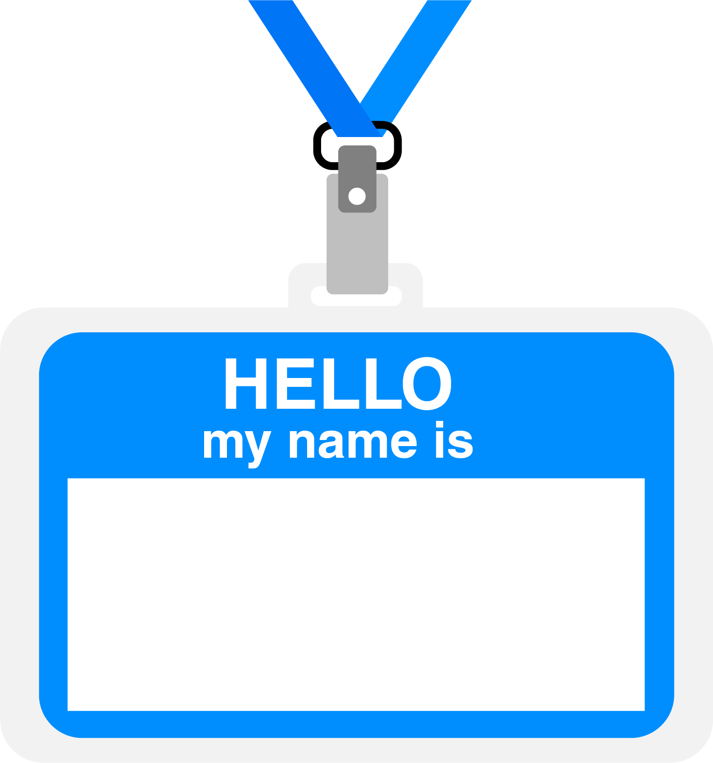

Hello
About me...
25+ years in the indusry
20+ years in teaching
Certified Cloud architect
Passionate about learning
Also, passionate about Reese’s Cups!
Allen Sanders
with DevelopIntelligence, a Pluralsight Company.
Notes:
Mandatory
ACTION: Adjust objectives to fit your course.
Script: I am [insert name] with DevelopIntelligence. We’re the training partner for [insert client name]. [Provide brief info on your background.]
Wing it!!! Keep it short!!! (Under 2 minutes; less than 1 is even better). Your goal is to establish rapport. You’re just trying to connect with the students. For example...
Here’s a little about my background in case you want this for reference later. Fun fact: [insert a piece of trivia about your personal life…”When I’m not teaching or coding, I am a skydiver”…whatever cool hobby you are engaged in]
Avoid putting your resume here. Say only a sentence or two about your professional credentials and invite them to ask questions about your background or experiences at any point during the training.

Slide 3
Prerequisites
This course assumes:
You have a working knowledge of 1 or more programming languages
This course is designed for existing software developers seeking to learn more about Kubernetes and how to use it
Notes:
Mandatory
ACTION: Adjust prerequisites to fit your course. Keep it brief.
Script: Before we start, I want to make sure everyone is in the correct class. Take a look at these prerequisites and message me in Chat if you have questions or aren’t sure you’re in the right spot.

Slide 4

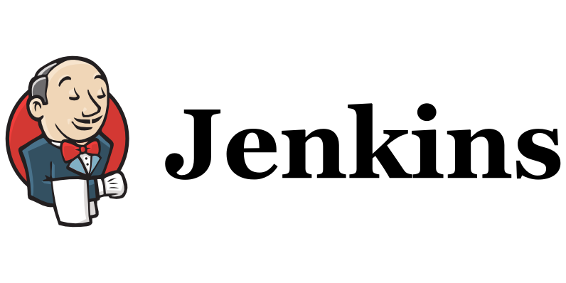






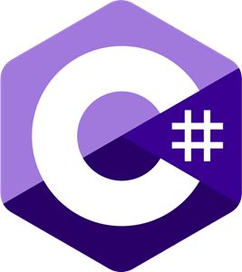



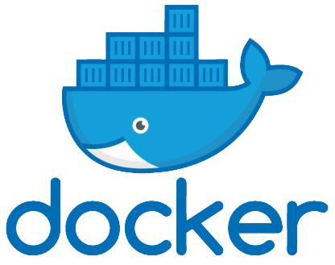



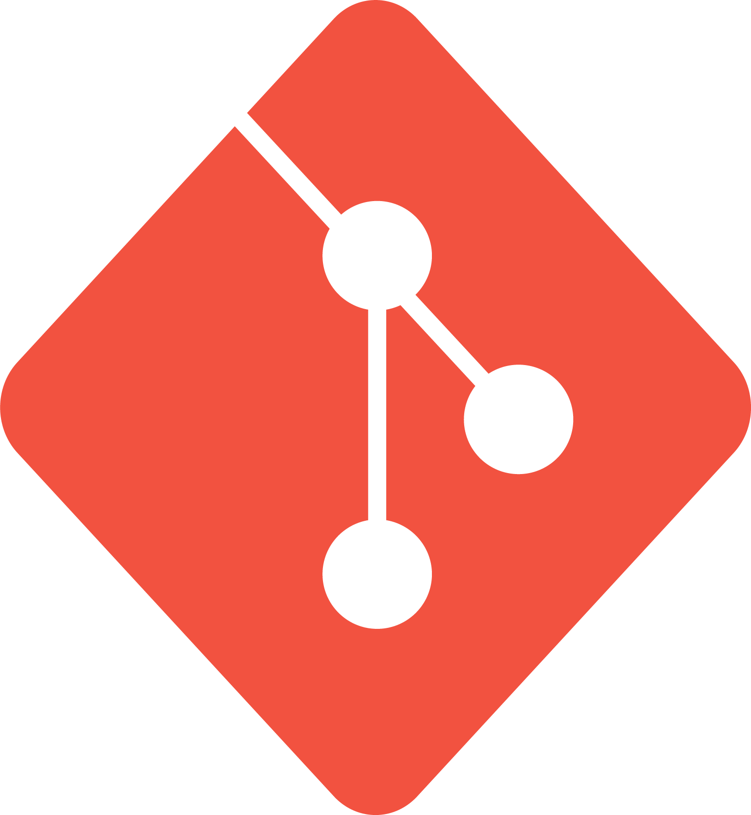
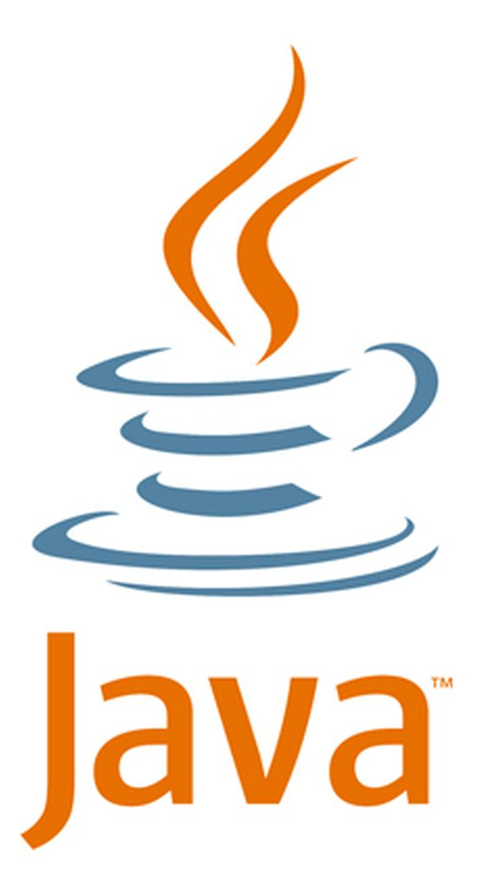

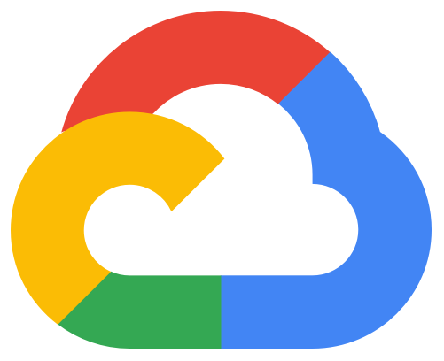
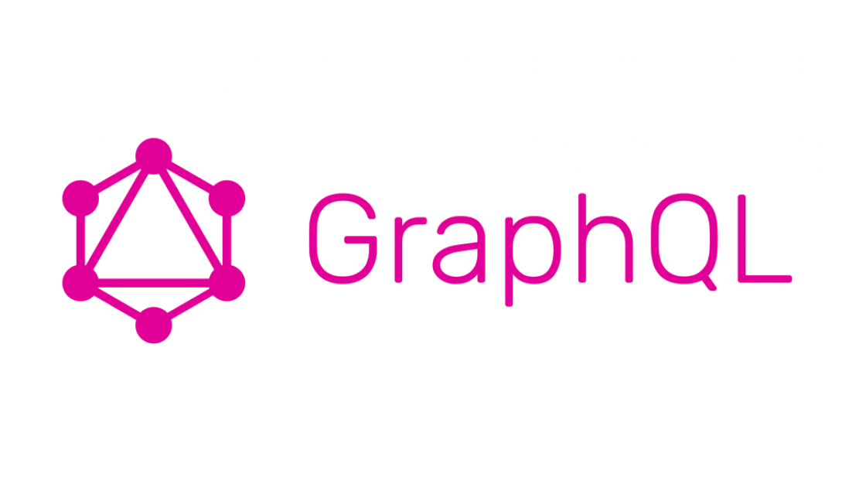
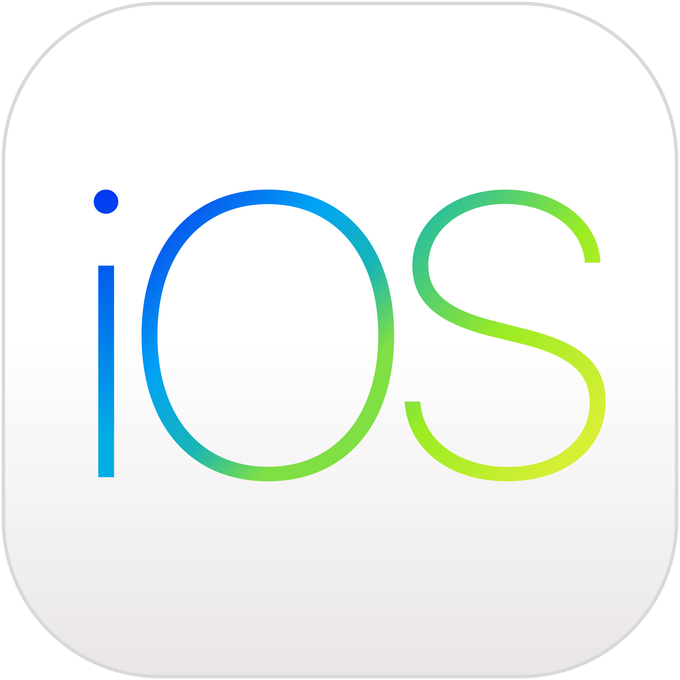
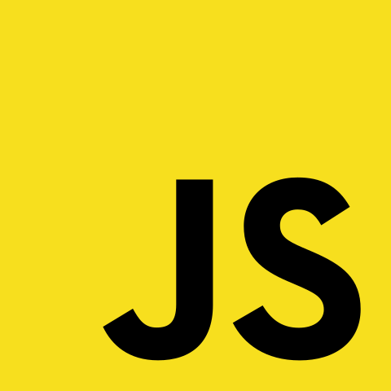

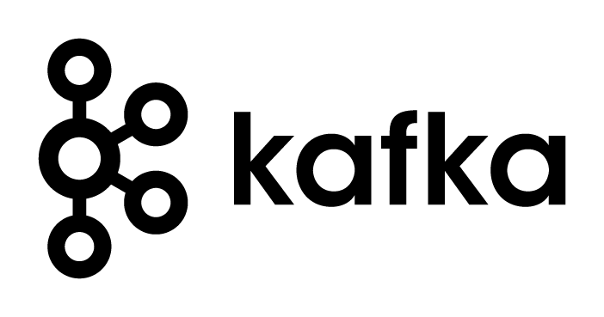
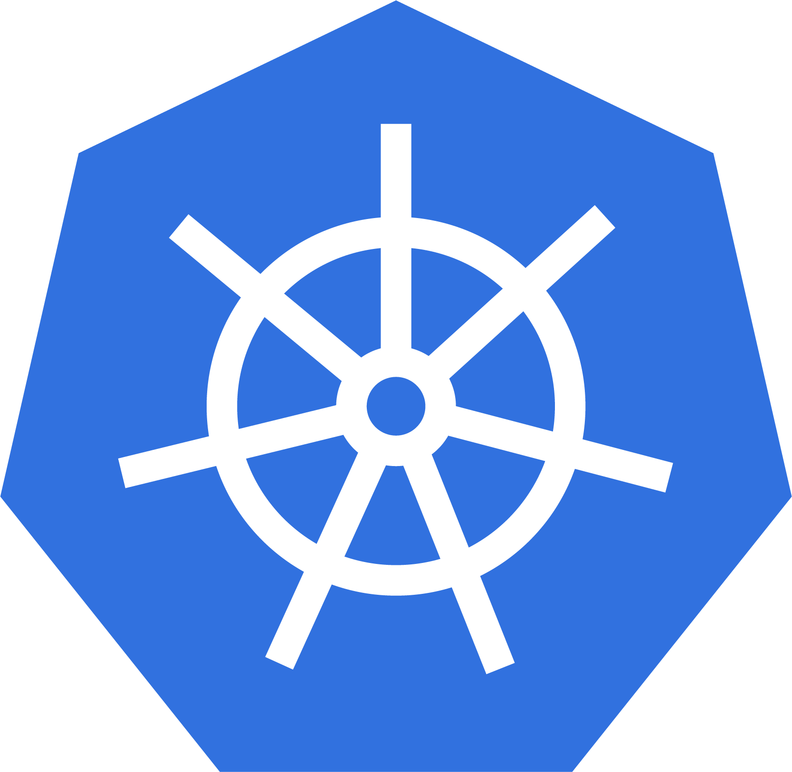

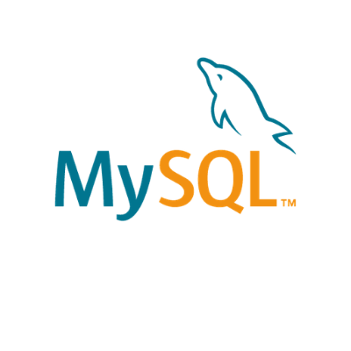

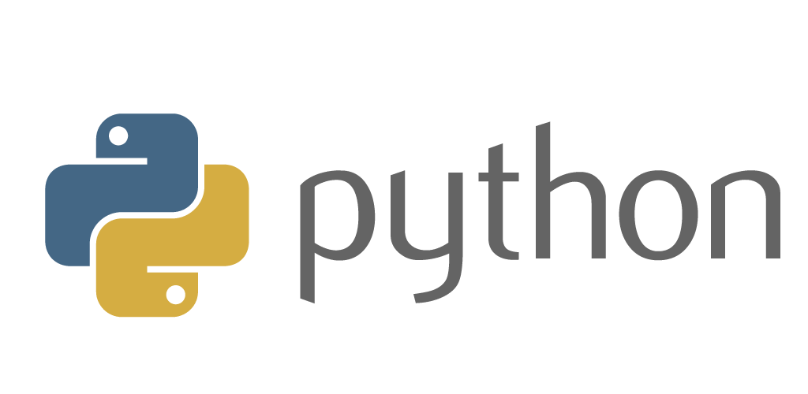
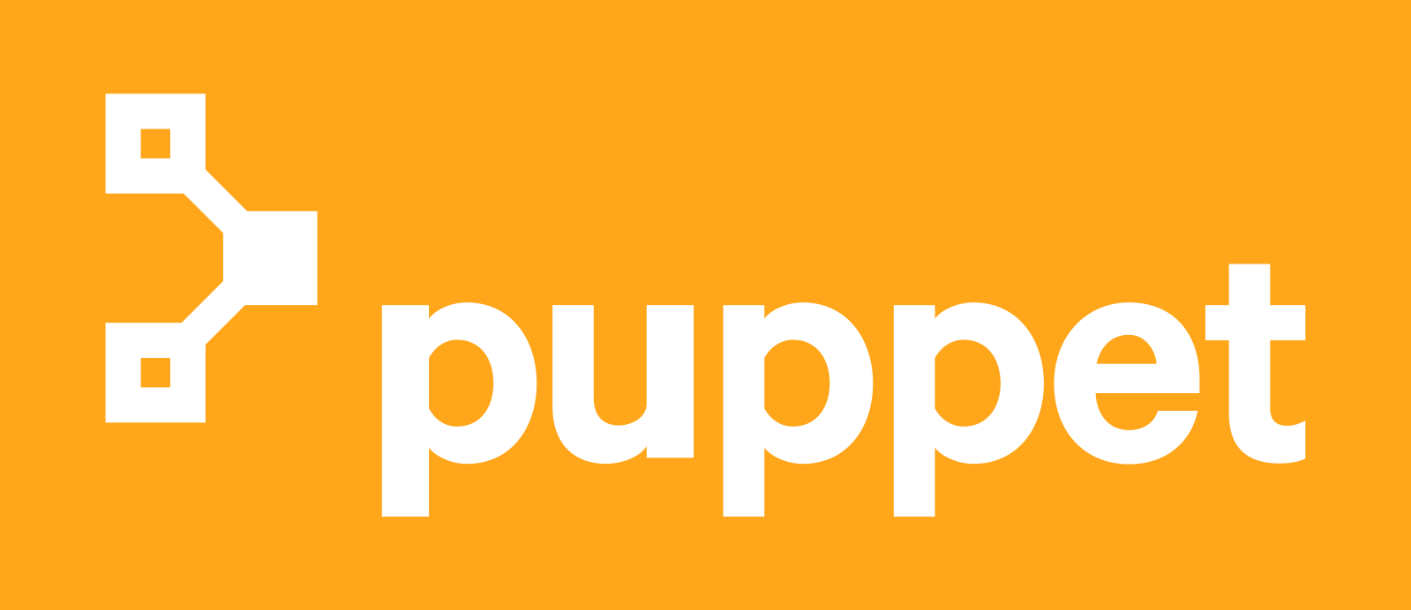

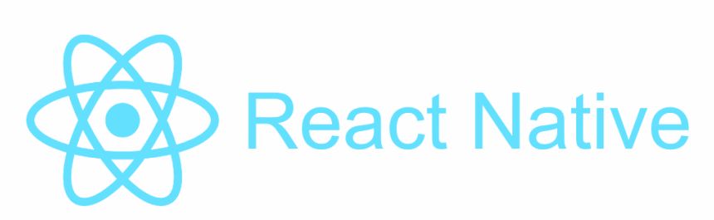
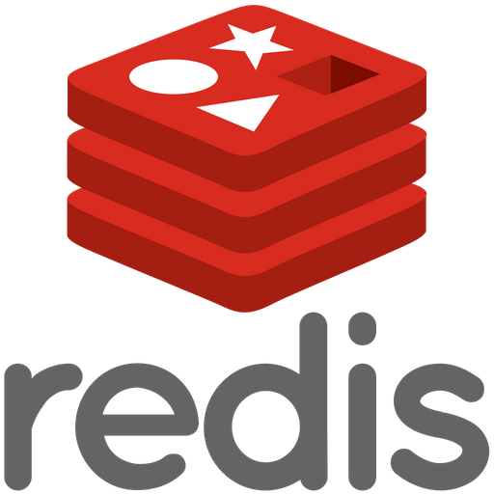


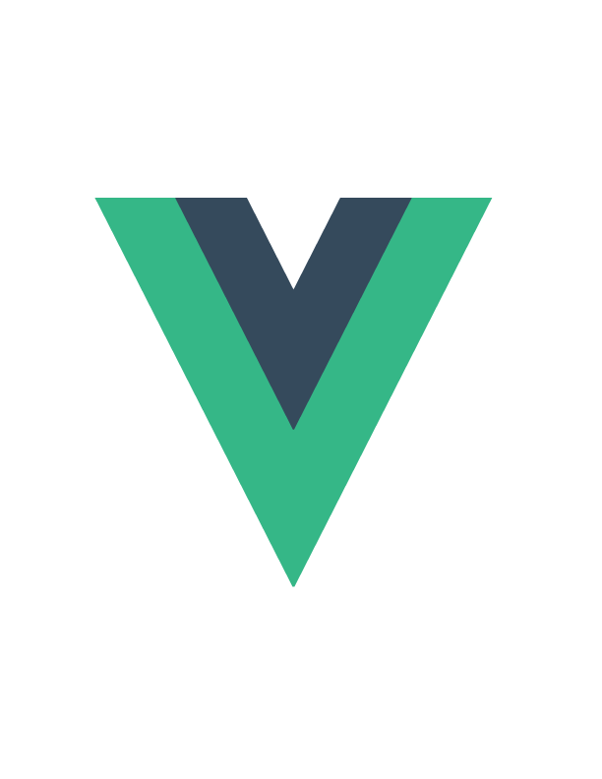

We teach over 400 technology topics
Notes:
Mandatory
Script: DevelopIntelligence teaches a lot of different tech. If there’s a technology you want to learn and you don’t see it in your company’s learning catalog, let your manager know. We’d be glad to help.”

Slide 5



You experience our impact on a daily basis!
Notes:
Mandatory
Script: In your everyday life, you come across tech many times a day. When you shop online. When you pay for your morning coffee. When you watch a movie or travel. We train software developers and IT professionals who work on many of the products and services you use daily.
In fact, when you talk on the phone, watch a movie, connect with friends on social media, drive a car, fly on a plane, shop online, and order a latte with your mobile app, you are experiencing the impact of our solutions.

Slide 6
My pledge to you
I will...
Make this interactive
Ask you questions
Ensure everyone can speak
Use an on-screen timer
Notes:
Mandatory
Script: This is my pledge to you. I’d like to talk in particular about the third bullet. Sometimes in a class, an enthusiastic participant will want to speak out in every discussion, answer every question and so forth. I want to make sure all of you have the opportunity to be heard. So, if I haven’t heard from you in awhile, I may call on you or check in via chat, because I want to make sure everyone gets their questions answered. Also, I want to demonstrate the timer and confirm that everyone can see it. EggTimer is a good timer - https://e.ggtimer.com/

Slide 7
Agenda
Kubernetes and container orchestration
How do Docker and K8s fit together?
Diving deeper into several Kubernetes primitives including Pods, Deployments, Services, ConfigMaps, Secrets, etc.
Discussion of key areas of focus like configuration, observability, and persistence
The architecture of a k8s cluster
High-level overview of Helm
Notes:
Mandatory
ACTION: Adjust agenda as per your course.
The agenda provides students a roadmap of where the class is going and what is coming up. Keep it high level, as there is no need to include “Gazornin” in the agenda if that’s something they don’t understand. Refer to the agenda at the beginning of the class, at the end of every day and at the beginning of every morning. In the mornings, the Agenda is a great way to facilitate a Q&A session about what was covered on the previous day.

Slide 8
How we’re going to work together
Slides / lecture
Demos
Team discussions
Labs
Hack-a-thon
Notes:
Mandatory
ACTION: Adjust bullets as per your course.
In this section, discuss the structure of the course—exercises, labs, etc.
Also, discuss any resources students will be using.

Slide 9
Containerization as a Deployment Strategy

Slide 10
Why Containerization?
Abstracts away the code implementation so you can deploy in a platform-agnostic manner, writing in the language of your choice
Aligns strongly with the principles and practices of DevOps
Helps leverage the power of the cloud
Speeds up important non-coding activities (infrastructure spin-up, testing, CI/CD tasks, DevSecOps, code quality checks, etc.
Helps breed consistency vs. “snowflake”
Notes:
[Mandatory slide]
ACTION: Adjust as per your course.
The “Why?” and the “What’s in it for me?” are key to setting the stage for the course and getting students primed to learn. It is a good practice to use a “Why?” slide before each new topic or module that is going to be taught.

Slide 11
What Do We Mean by Application Hosting?
The target infrastructure and runtime platform that will be employed for deployment and execution of an application or system
Can include compute (CPU and server resources), storage, network, data and operating system
Notes:
Reminder – covered in Working with Cloud

Slide 12
What Are the Hosting Options with Cloud?
IaaS
PaaS
Serverless / FaaS
SaaS
Containers
Notes:
Reminder – covered in Working with Cloud

Slide 13
Containers
Form of virtualization at the app packaging level (like virtual machines at the server level)
Isolated from one another at the OS process layer (vs VM’s which are isolated at the hardware abstraction layer)
Images represent the packaging up of an application and its dependencies as a complete, deployable unit of execution (code, runtime and configuration)
Notes:
What are virtual machines? Virtual (vs. physical) computers built using images that support independent execution of and interaction with an instance built from the image and running against a “slice” of the physical host’s resources. Multiple VM instances can be run on the same physical host at the same time and are managed by a program called a hypervisor.
Containers are isolated from one another at the OS process layer (vs VM’s which are isolated at the hardware abstraction layer)

Slide 14
Containers
A platform (e.g., Docker) running on a system can be used to dynamically create containers (executable instances of the app) from the defined image
Typically, much, much smaller than a VM which makes them lightweight, quickly deployable and quick to “boot up”
An orchestration engine (e.g., Kubernetes) might be used to coordinate multiple instances of the same container (or a “pod” of containers) to enable the servicing of more concurrent requests (scalability)

Slide 15
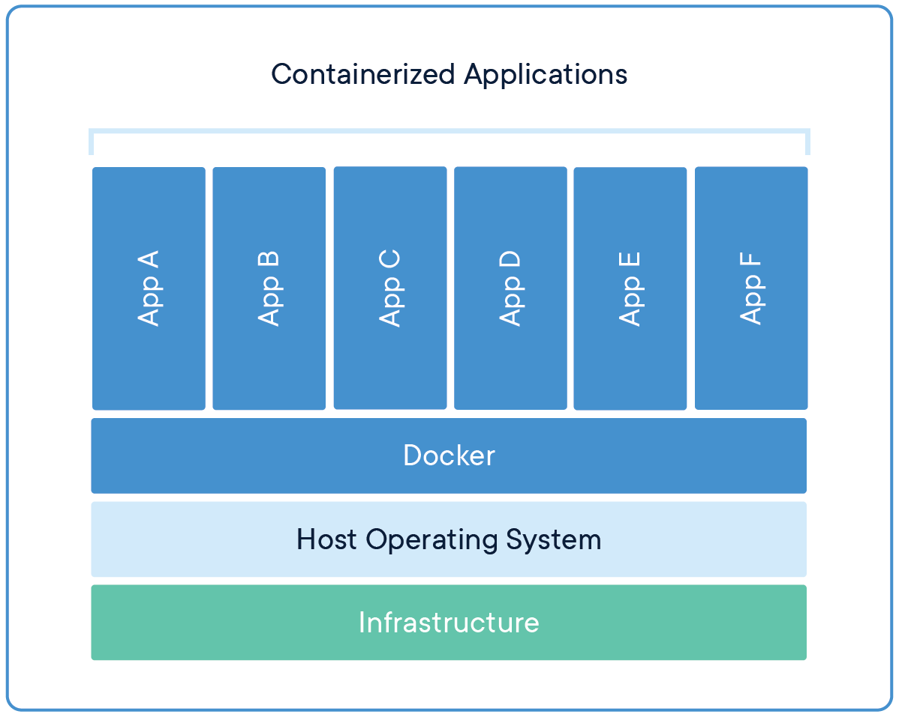
Containers

Slide 16
What are Microservices?
An architectural style in which a distributed application is created as a collection of services that are:
Highly maintainable and testable
Loosely coupled
Independently deployable (by extension, independently-scalable)
Domain centric and organized around business capabilities
The Microservices architecture enables the continuous deployment and delivery of large, complex distributed applications

Slide 17
What is a Monolith?
Typical enterprise application
Large codebases
Set technology stack
Highly coupled elements
Whole system affected by failures
Scaling requires the duplication of the entire app
Minor changes often require full rebuild

Slide 18
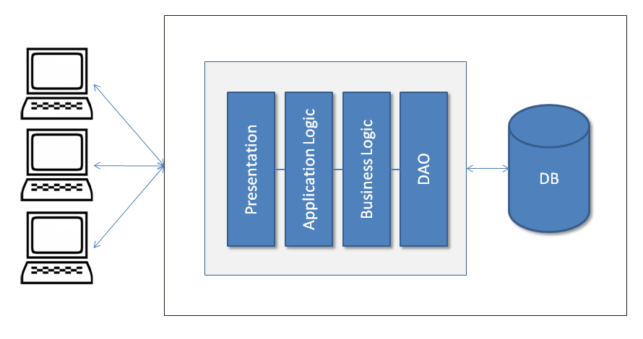
Monolithic Architecture Example

Slide 19
Moving to Microservices
We have moved towards a refinement of “what is a service?”
Even in SOA, we can create a service that does more than one thing – using it to solve an overall business problem, rather than one part of the actions needed to solve that problem
This was moving us back towards monolithic
We arrive at a point where we want individual, purposeful services that do one thing and do it well – the microservice

Slide 20
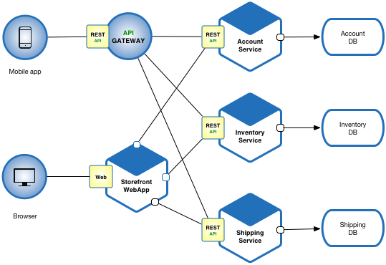
Example Microservices Architecture

Slide 21
Microservices – Benefits vs. Costs
Benefits:
Enables work in parallel
Promotes organization according to business domain
Advantages from isolation
Flexible in terms of deployment and scale
Flexible in terms of technology

Slide 22
Microservices – Benefits vs. Costs
Costs:
Requires a different way of thinking
Complexity moves to the integration layer
Organization needs to be able to support re-org according to business domain (instead of technology domain)
With an increased reliance on the network, you may encounter latency and failures at the network layer
Transactions must be handled differently (across service boundaries)
Notes:
Mention Conway’s Law
Talk about new customer operation with initial deposit – those operations need to happen transactionally

Slide 23
Microservices & Containers
Microservices – with their smaller size, independently-deployable and independently-scalable profile, and encapsulated business domain boundary – are a great fit for containers
Using Kubernetes, sophisticated systems of integrated microservices can be built, tested and deployed
Leveraging the scheduling and scalability benefits of Kubernetes can help an organization target scaling across a complex workflow in very granular ways
This helps with cost management as you can toggle individual parts of the system for optimized performance

Slide 24
Microservices & the Cloud
Microservices have broad support across multiple Cloud providers
One option includes standing up VM’s (IaaS) and installing / managing a Kubernetes cluster on those machines or
Another option includes leveraging a managed service (PaaS) provided by the CSP
Microservices are a great option for the Cloud because the elastic scalability provided by the Cloud infrastructure can directly support the independent scalability needed with a microservices architecture

Slide 25
Microservices Summary
Applications that can
Efficiently scale
Are flexible
Are high performance
These apps are powered by multiple services, working in concert
Each service is small and has a single focus
We use a lightweight communication mechanism to coordinate the overall system
This ends up giving us a technology agnostic API

Slide 26
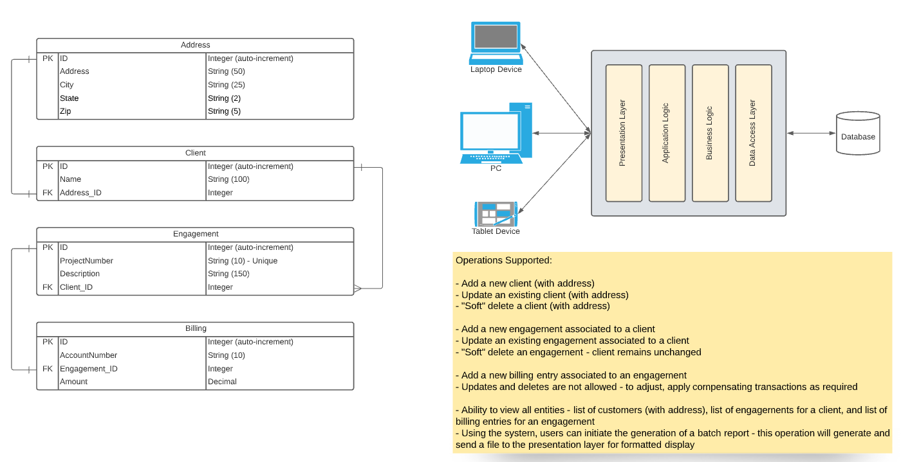
Use Case Discussion – Monolith to Microservices

Slide 27
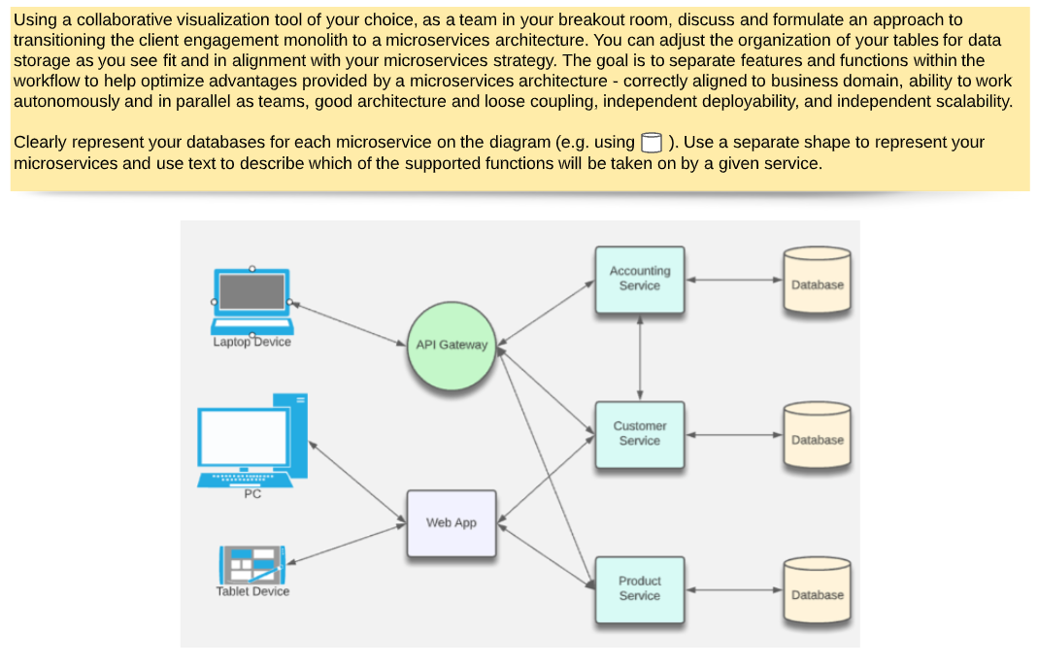
Use Case Discussion – Exercise

Slide 28
Stateless Applications and Scaling
If state is held in your application, scaling is very hard. Why?
Where can we get state info if it’s not held in the application?
If we build to resist failure, scaling is hard. Why?
How can we build to embrace failure?

Slide 29
Modern Approaches to Application Development
Leverage the cloud
Abstract away as much of the non-code elements as possible
Use the tools that arise from DevOps (automation, feedback, etc.)
Integrate testing and code quality checks early (“Shift Left”)

Slide 30
Design Approaches to Modern Applications
Decompose when possible
Embrace Failure
Separate the language from the function of the code

Slide 31
Infrastructure as Code (IaC)
Declarative vs. Imperative coding
Drawbacks of declarative infrastructure
Impact of IaC on the dev process, on testing, and on deployment

Slide 32
Set up Local k8s Dev Environment
Activate Kubernetes now, via Docker Desktop
Use kubectl from command line to see k8s config data and confirm setup
Optional: Install Docker/k8s extensions/plugins for your IDE

Slide 33
Lab 01

Slide 34
Quick Refresh on Docker

Slide 35
What is Docker?
Built around the concept of images & containers
Also, supports composition of a set of containers to be deployed together
For example, application code + network components + database components

Slide 36
What is Docker?
Utilizes principles of “immutable infrastructure”
Complete application environments torn down and recreated as needed
Helps to minimize infrastructure “drift” and environment inconsistencies

Slide 37
The Dockerfile
Tells Docker what to do in creating an image for your application
The commands are all things you could do from the CLI
Used by the docker “build” command
Docker build uses this file and a “context” – a set of files at a specified location – to make your image

Slide 38
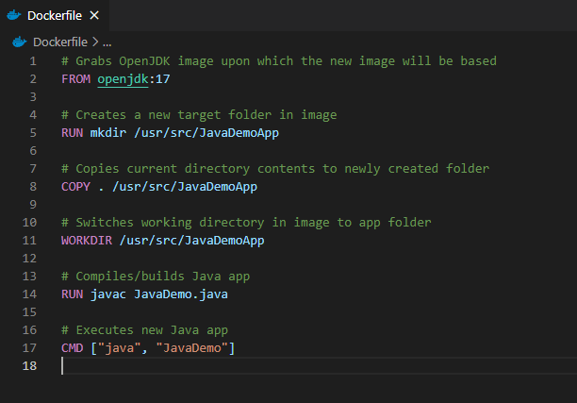
Dockerfile example
The following creates an image for building/running Java app in container
See https://github.com/KernelGamut32/dockerlab-repo-sample for sample

Slide 39
Docker Images
Represent templates defining an application environment
New instances of the application can be created from the image
These instances are called containers

Slide 40
Docker Images
Images are defined via a Dockerfile definition
Support layers for building up the environment in stages
Fully defines the application, including all components required to support

Slide 41
Docker Images
Those components can include:
Runtime
Development framework
Source code
Executable instructions for container startup

Slide 42
Docker Images
Start with a base that gives your app a place to live
Needed OS/runtimes/dB server applications, etc.
Examples:
nginx
Node
MySQL
Apache HTTP Server
IIS with .NET Runtimes

Slide 43
Docker Hub
Centralized registry for image storage & sharing
Can signup for an account – user accounts offer both free and pro versions
Also, supports organizations for grouping of multiple team members

Slide 44
Docker Hub
Accessible at https://hub.docker.com
Search feature enables search for image by technology or keyword
Image detail displays available tags and image variants

Slide 45
Docker Hub
May also include examples of usage
Pro account supports image scanning for security vulnerabilities
Can be useful for image reuse and image sharing across a dev team

Slide 46
Docker Hub
There are other registry types, including private registries

Slide 47
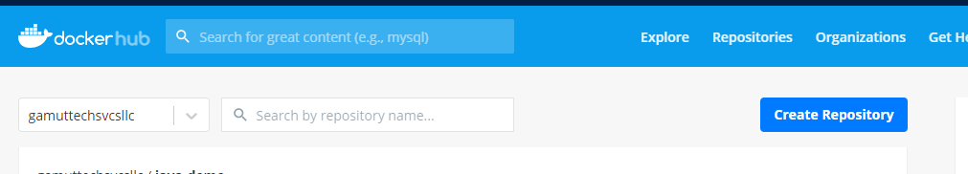
Docker Hub

Slide 48
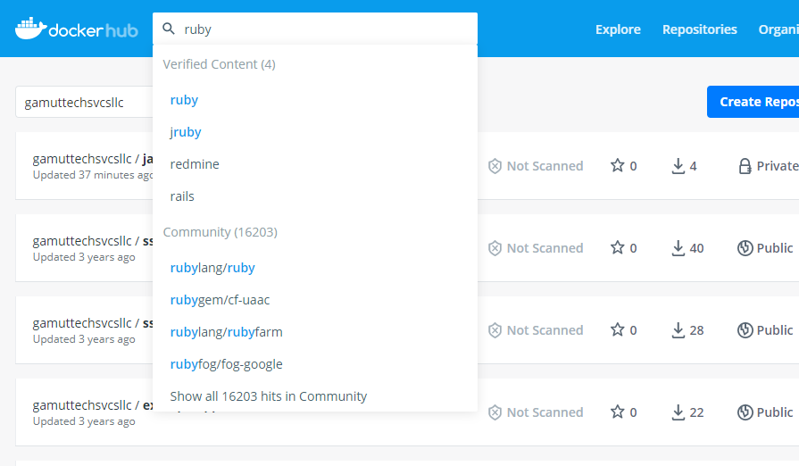
Docker Hub

Slide 49
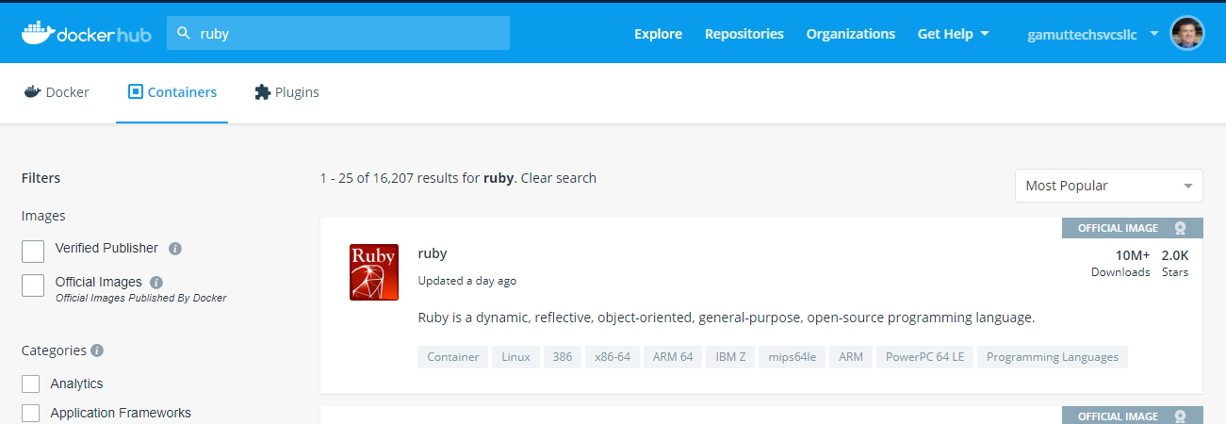
Docker Hub

Slide 50
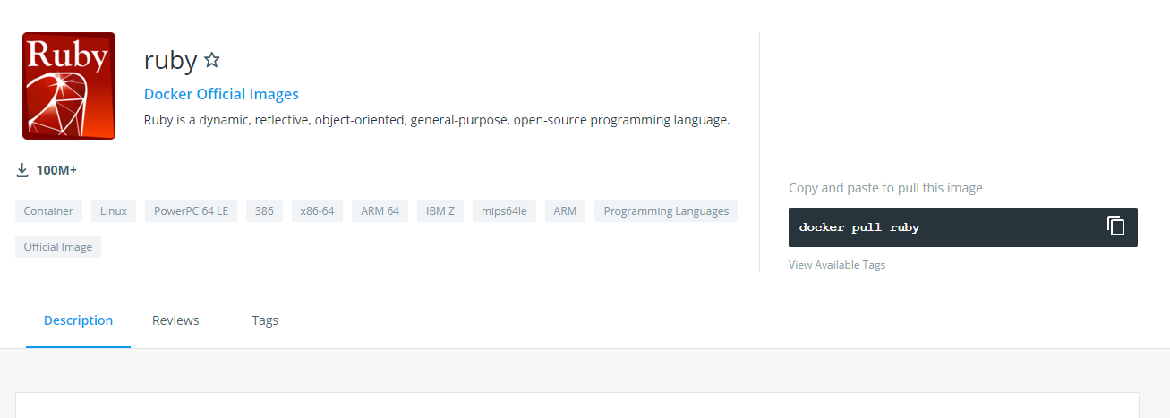
Docker Hub

Slide 51
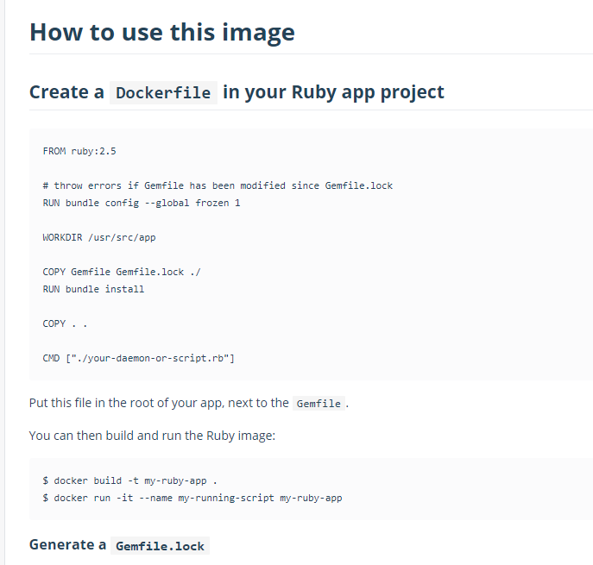
Docker Hub

Slide 52
Building The Image
To build the image from Dockerfile use docker build
docker build -t <tag name> <path to Dockerfile>
For example, docker build -t java-demo .
Builds image from Dockerfile in current folder (.) with tag name “java-demo”

Slide 53
Building The Image
For tag name, can include optional detail:
Docker ID in Docker Hub for eventual push to image registry
Version identifier for tag – defaults to “latest” if excluded
For example, docker build -t <docker ID>/<tag name>:<version> .

Slide 54
Application Bootstrapping with Docker and k8s
Kubernetes provides a hosting environment for containerized applications
Once you have a Docker image, you can work entirely within Kubernetes to deploy your app

Slide 55
Open Container Initiative (OCI)
The OCI is an open governance structure for the express purpose of creating open industry standards around container formats and runtimes
Docker started it
They have two specs: runtime-spec and image-spec
This deals with containers in the abstract

Slide 56
Competing Container Runtimes
rkt from CoreOS
Mesos from Apache
LXC Linux containers

Slide 57
Lab 02

Slide 58
Kubernetes and Container Orchestration

Slide 59
Kubernetes (k8s) Overview
Kubernetes is a portable, extensible, open-source platform for managing containerized workloads and services

Slide 60
What is an Orchestrator and Why Do We Need It?
What would it look like to manually control the containers needed for your application as your app scales or containers fail?
“Orchestration” is the execution of a defined workflow
We can use an orchestrator to start and stop containers automatically based on your set rules
What does this open up for you?

Slide 61
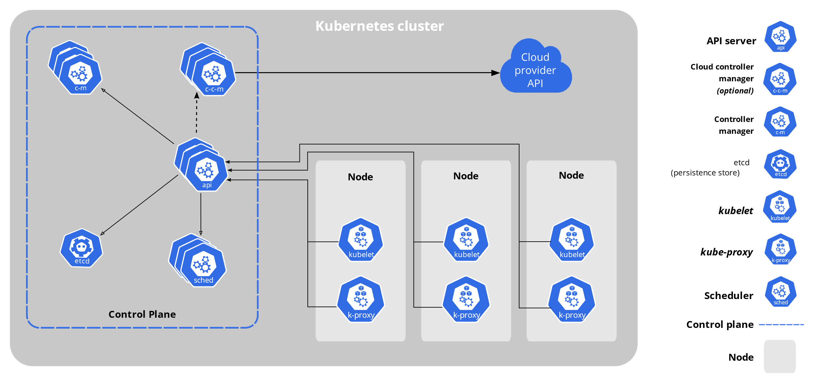
Architecture of k8s System

Slide 62
Core Components of k8s
When you deploy Kubernetes, you get a cluster.
A Kubernetes cluster consists of a set of worker machines, called nodes, that run containerized applications. Every cluster has at least one worker node.
The worker node(s) host the Pods that are the components of the application workload.
The control plane manages the worker nodes and the Pods in the cluster.

Slide 63
k8s Resource/Manifest
Kubernetes manifests are text files, usually written in YAML
They are used to create, modify and delete Kubernetes resources

Slide 64
Kubernetes Architecture
Kubernetes automates and monitors the lifecycle of a stateless application
It can scale the app up or down and ensure it keeps running
Kubernetes cluster consists of computers called nodes
The basic unit of work in kubernetes is called a pod, which is a group of one or more containers
Kubernetes can be divided into planes
Control plane - the actual pods that the kubernetes core components runs on, exposing the api, etc...
Data Plane - everything else meaning the nodes and pods which the application runs on

Slide 65
Kubernetes Architecture
In short, control plane is what monitors the cluster, schedules the work, makes the changes, etc…
The nodes are what actually do the real work, report back to the master, and watch for changes

Slide 66
Kubernetes Control Plane & Data Plane
Kubernetes is actually a collection of pods implementing the k8s api and the cluster orchestration logic (AKA the Kubernetes control plane)
The application/data plane is everything else, meaning all the nodes that host all the pods that the application runs on
The controllers of the control plane implement control loops that repeatedly compare the desired state of the cluster to its actual state
When the state of the cluster changes, controllers take action to bring it back inline with desired state

Slide 67
Declarative and Desired State
Kubernetes supports a declarative model – we can send the api a yaml file in a declarative form
Desired state means that we specify in the yaml file our desired state and the cluster takes responsibility to make sure it will happen
We describe the desired state using a yaml or json file that serves as a record of intent, but we do not specify how to get there (this is kubernetes responsibility to get us there)
Things could change or go wrong over the lifetime of the cluster (node failing, etc…), Kubernetes is responsible to always make sure that the desired state is kept intact
Kubernetes control plane controllers are always running in a loop and checking that the actual state of the cluster matches the desired state, so that if any error occurs they kick in and rectify the cluster

Slide 68
Reconciling state
Watch for the spec fields in the YAML files
The spec describes what we want the thing to be
Kubernetes will reconcile the current state with the spec (technically, this is done by a number of controllers)
When we want to change a resource, we update the spec, and reapply
Kubernetes will then converge that resource

Slide 69
k8s Pods: The Basic Building Block
A pod represents a set of running containers in your cluster
Worker nodes host pods
The control plane manages the worker nodes and the pods inside them

Slide 70
k8s Pods: The Basic Building Block
Pod is the basic execution and scaling unit in Kubernetes
Kubernetes runs containers but always inside pods
It is like a sandbox in which containers run (abstraction)
A pod is a group of containers:
Running together (on the same node)
Sharing resources (RAM, CPU; but, also, network, volumes, etc…)
A Pod models an application-specific “logical host”

Slide 71
Pod state
Pods are considered to be relatively ephemeral (rather than durable) entities
Pods do not hold state, so if a pod crashes, Kubernetes will replace it with another
Multiple instances of the same pod are called replicas

Slide 72
Deployments
A Deployment controller provides declarative updates for Pods and ReplicaSets
The Deployment Object gives us a better way of handling the scaling of pods
The advantage of using Deployment versus using a replicaset is having rolling updates support for the pod container versions out-of-the-box

Slide 73
Deployments
Every time the application code changes, a new version of the application container is built, and then there is a need to update the Deployment manifest with the new version and tell K8s to apply the changes
K8s will then handle the rolling-out of this newer version, terminating pods with the old version as it spins up the new pods with the updated container
This means that at some point we will have multiple versions of the same application running at the same time

Slide 74
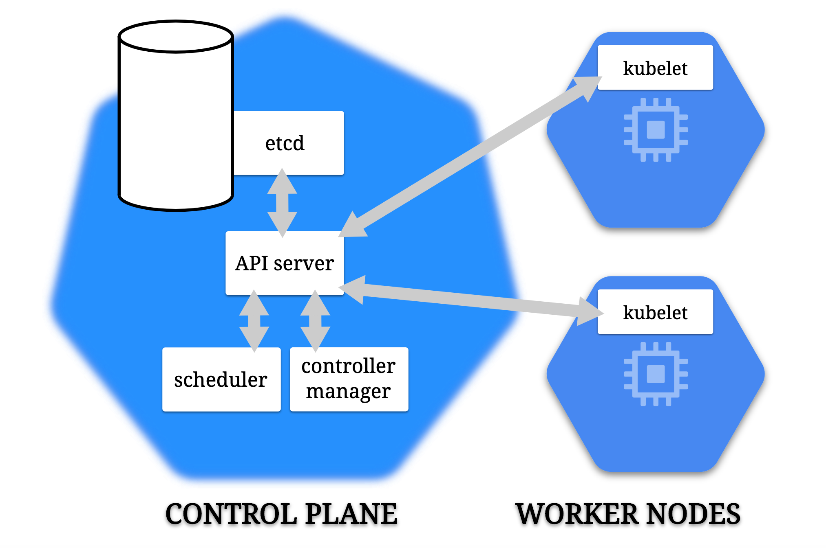

Slide 75
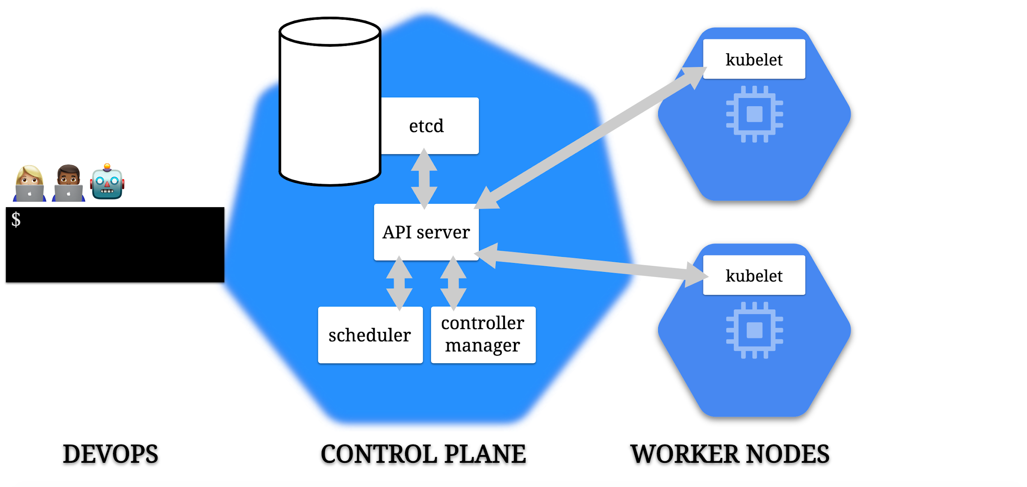

Slide 76
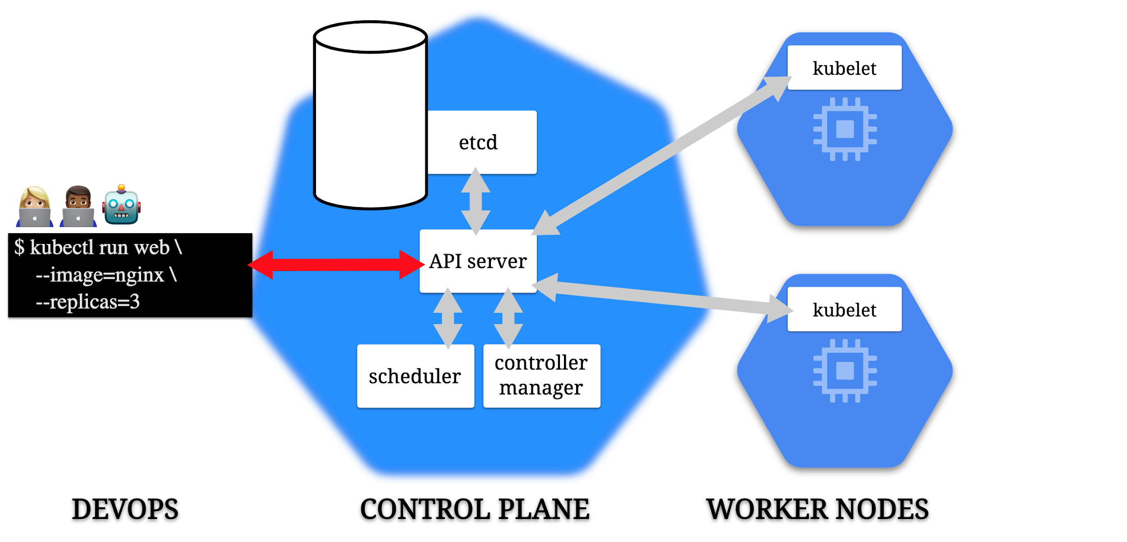

Slide 77
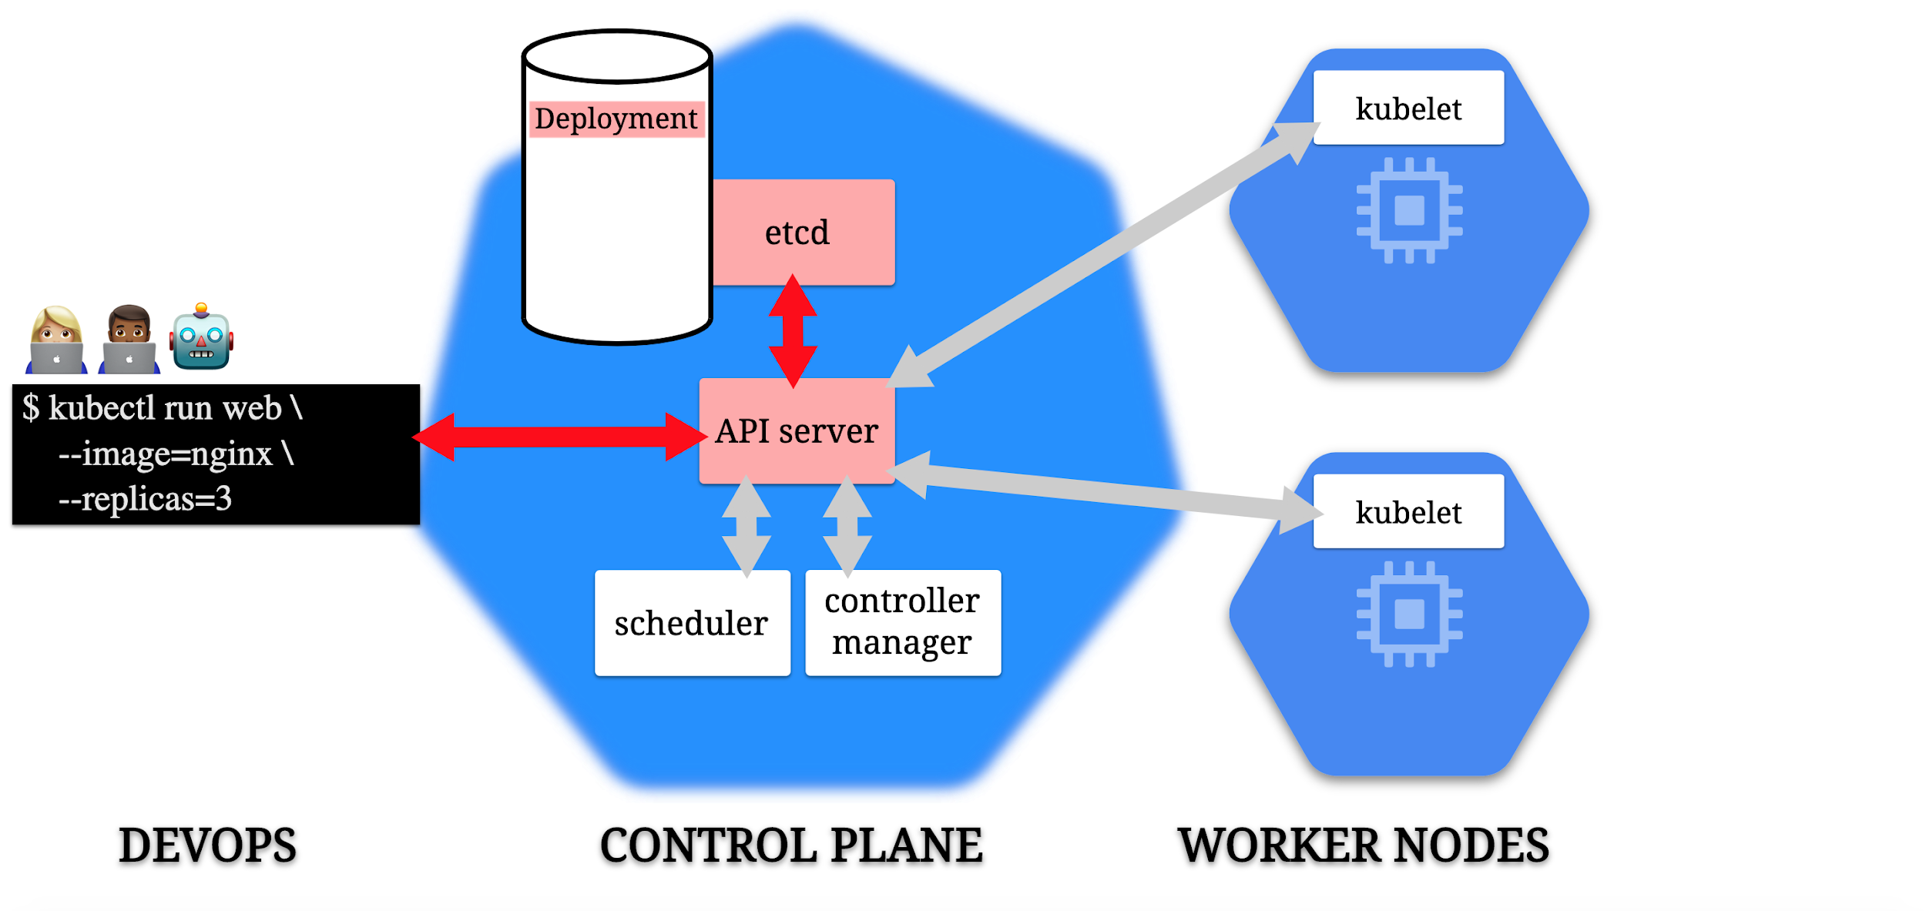

Slide 78
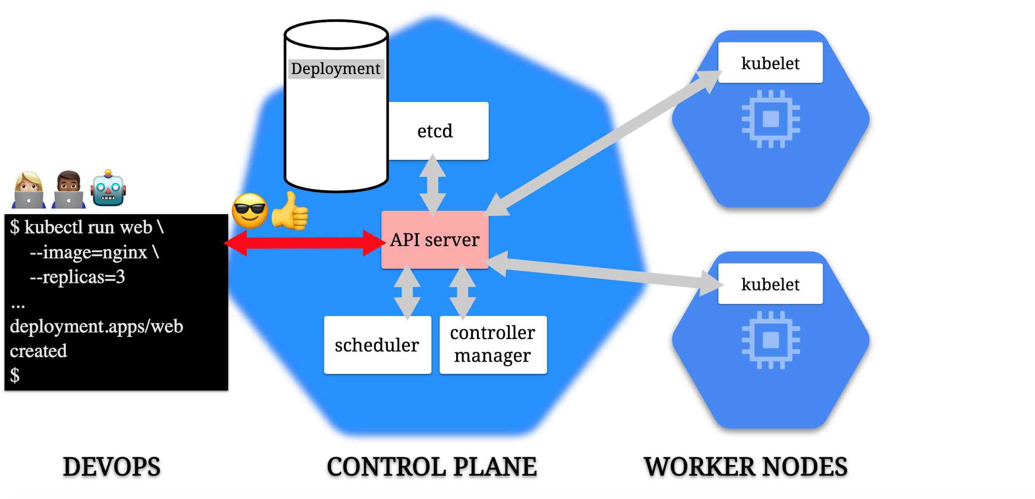

Slide 79
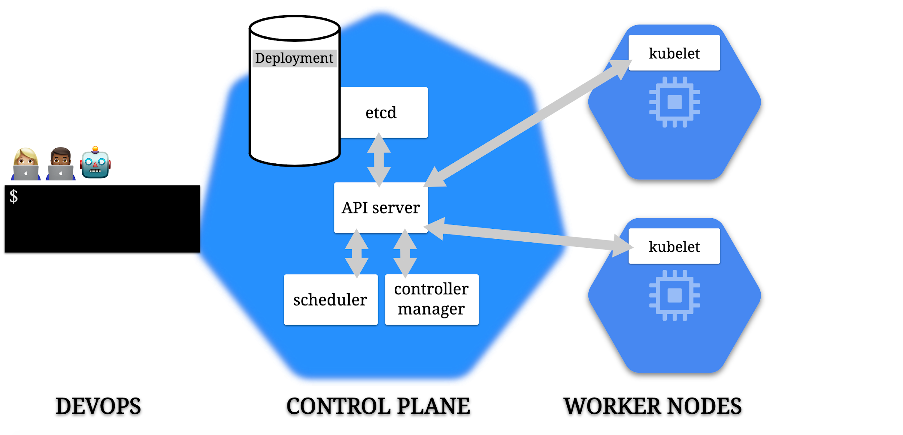

Slide 80
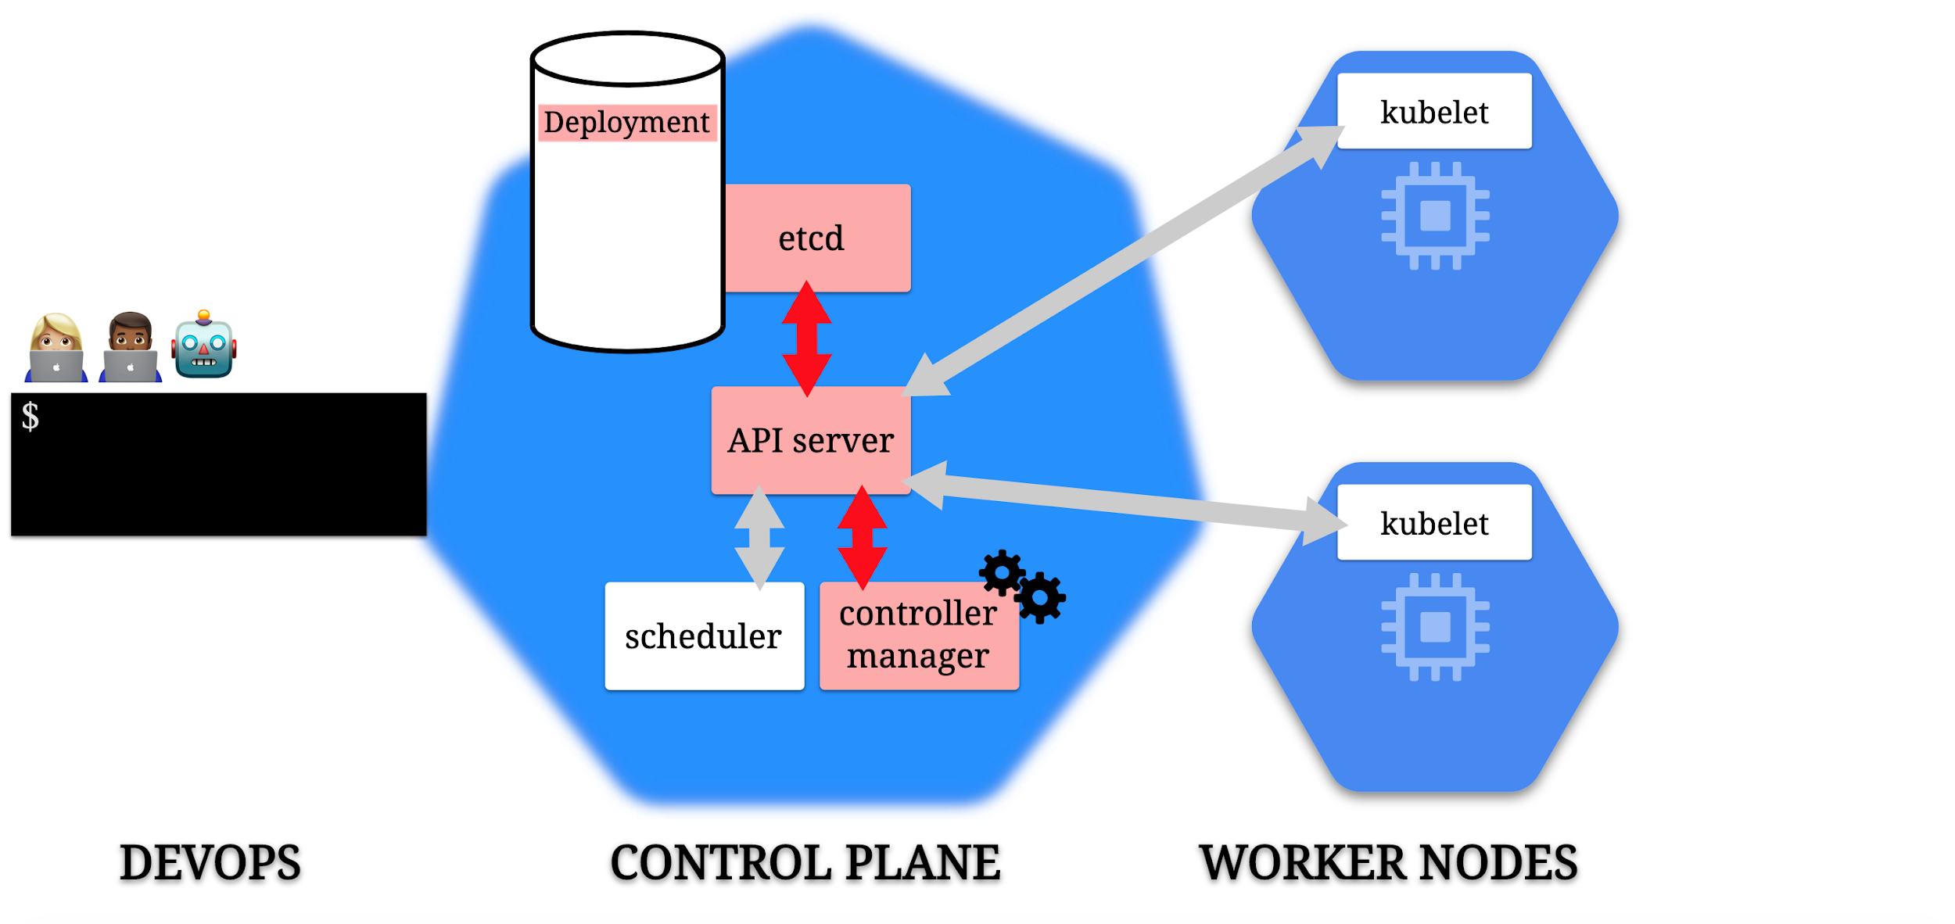

Slide 81
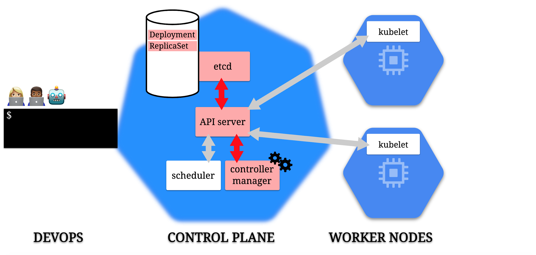

Slide 82
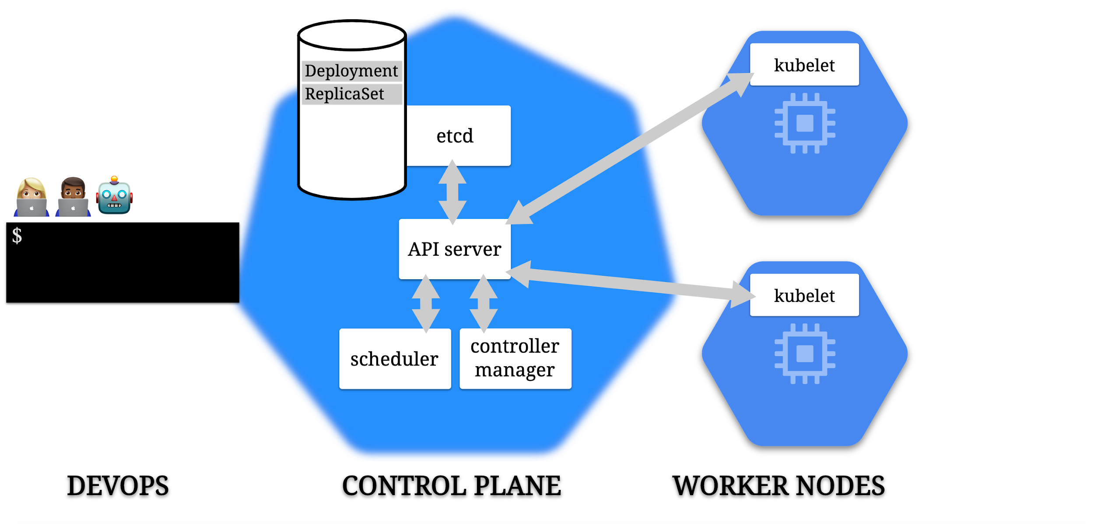

Slide 83
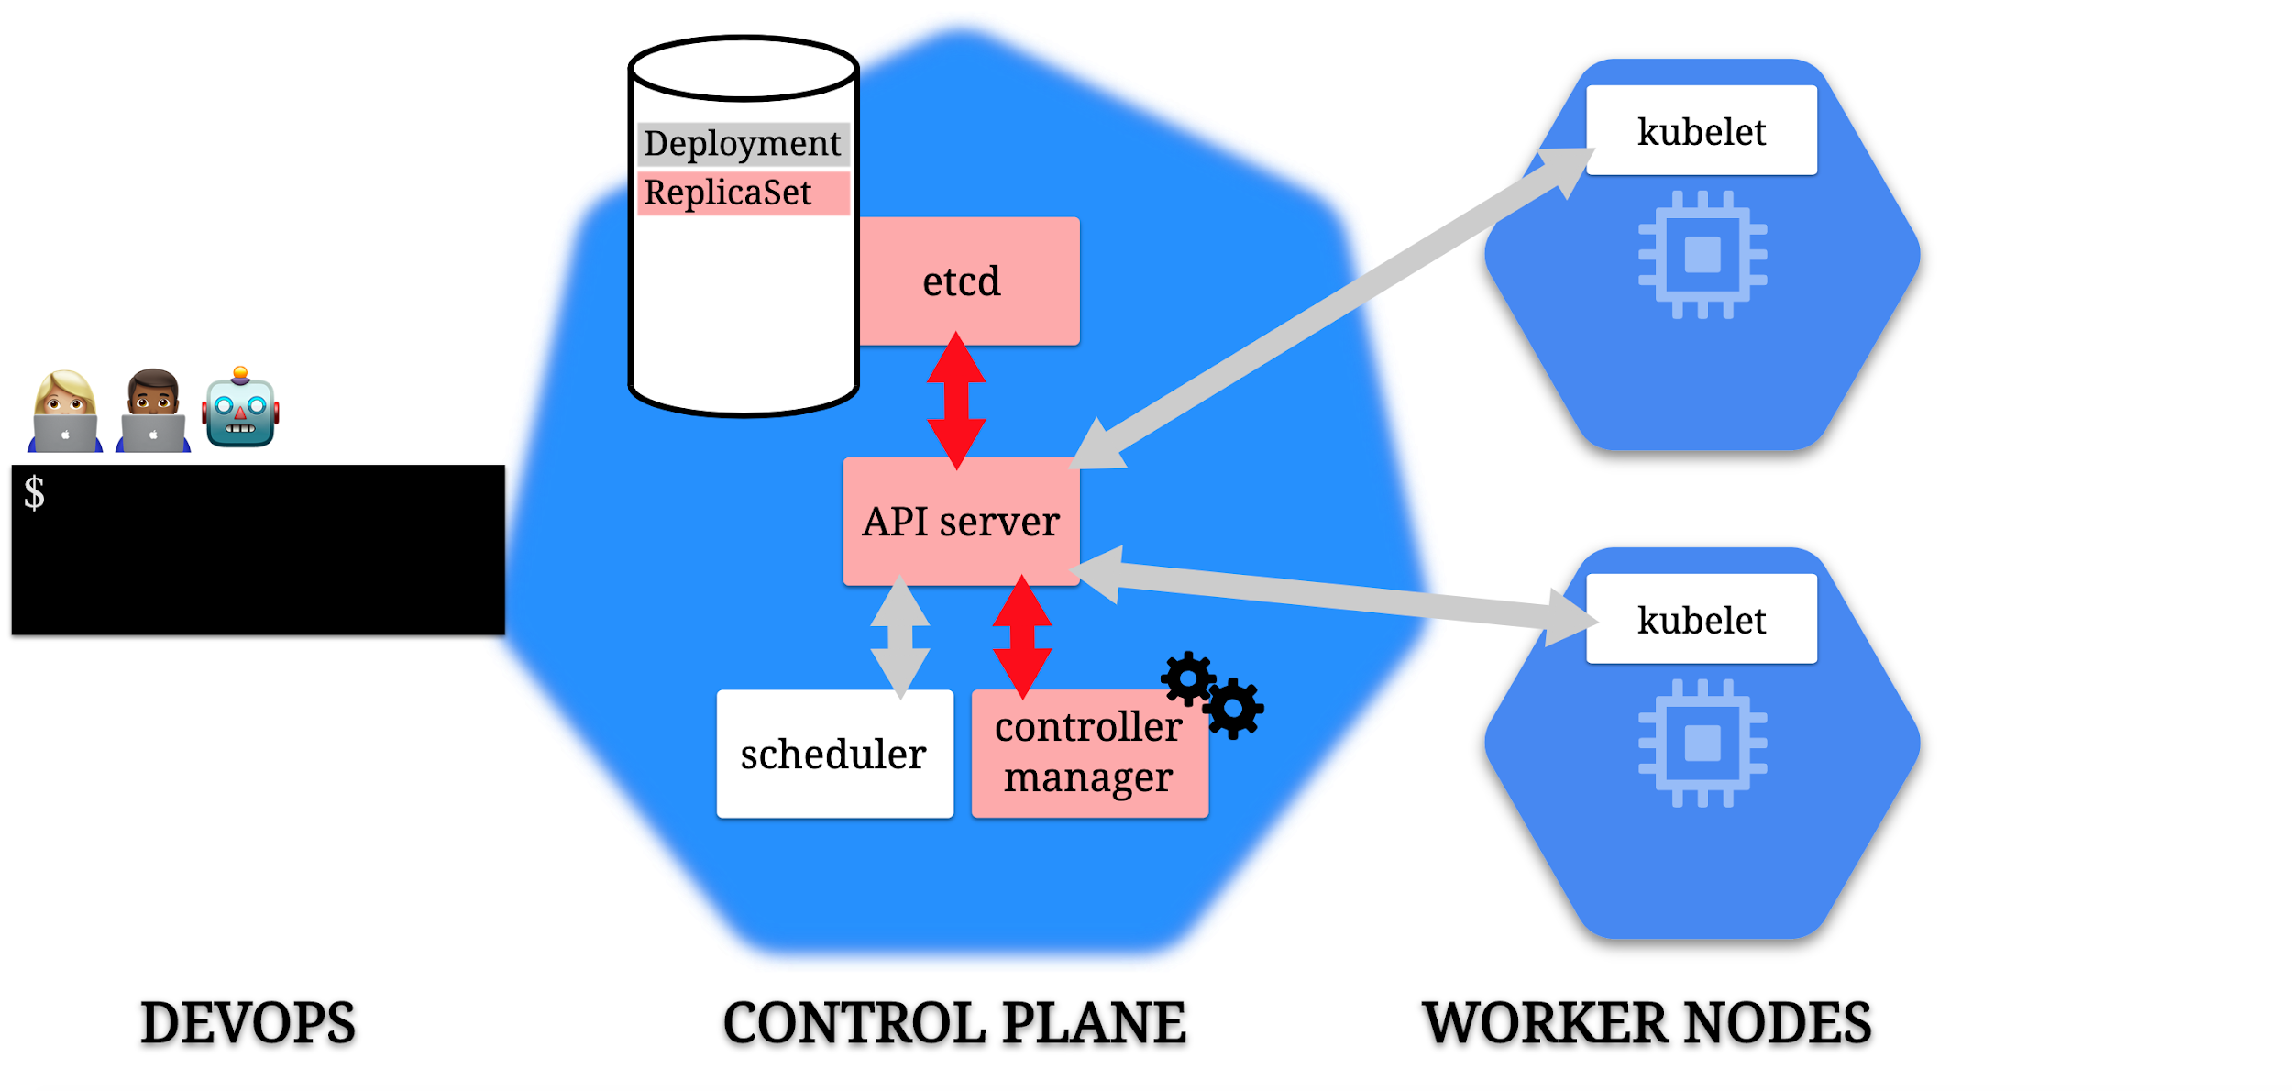

Slide 84
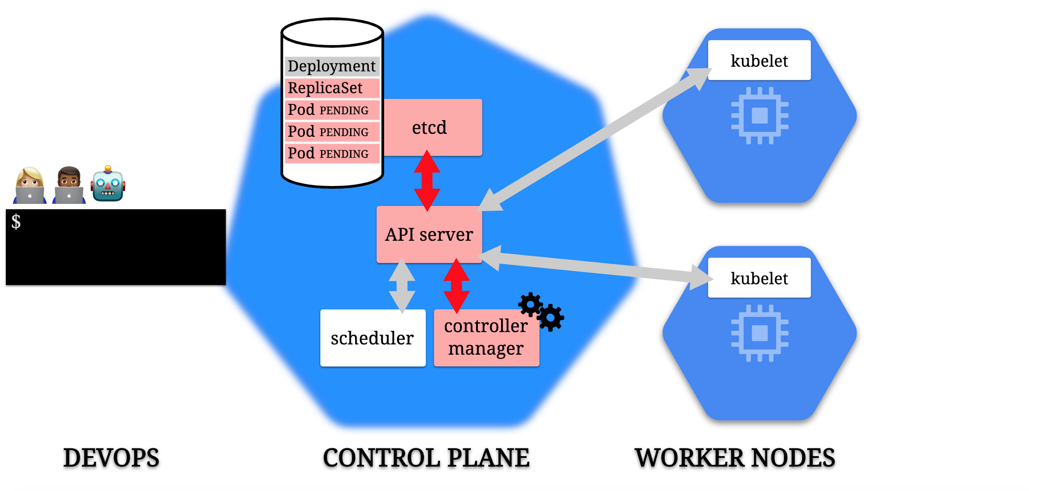

Slide 85
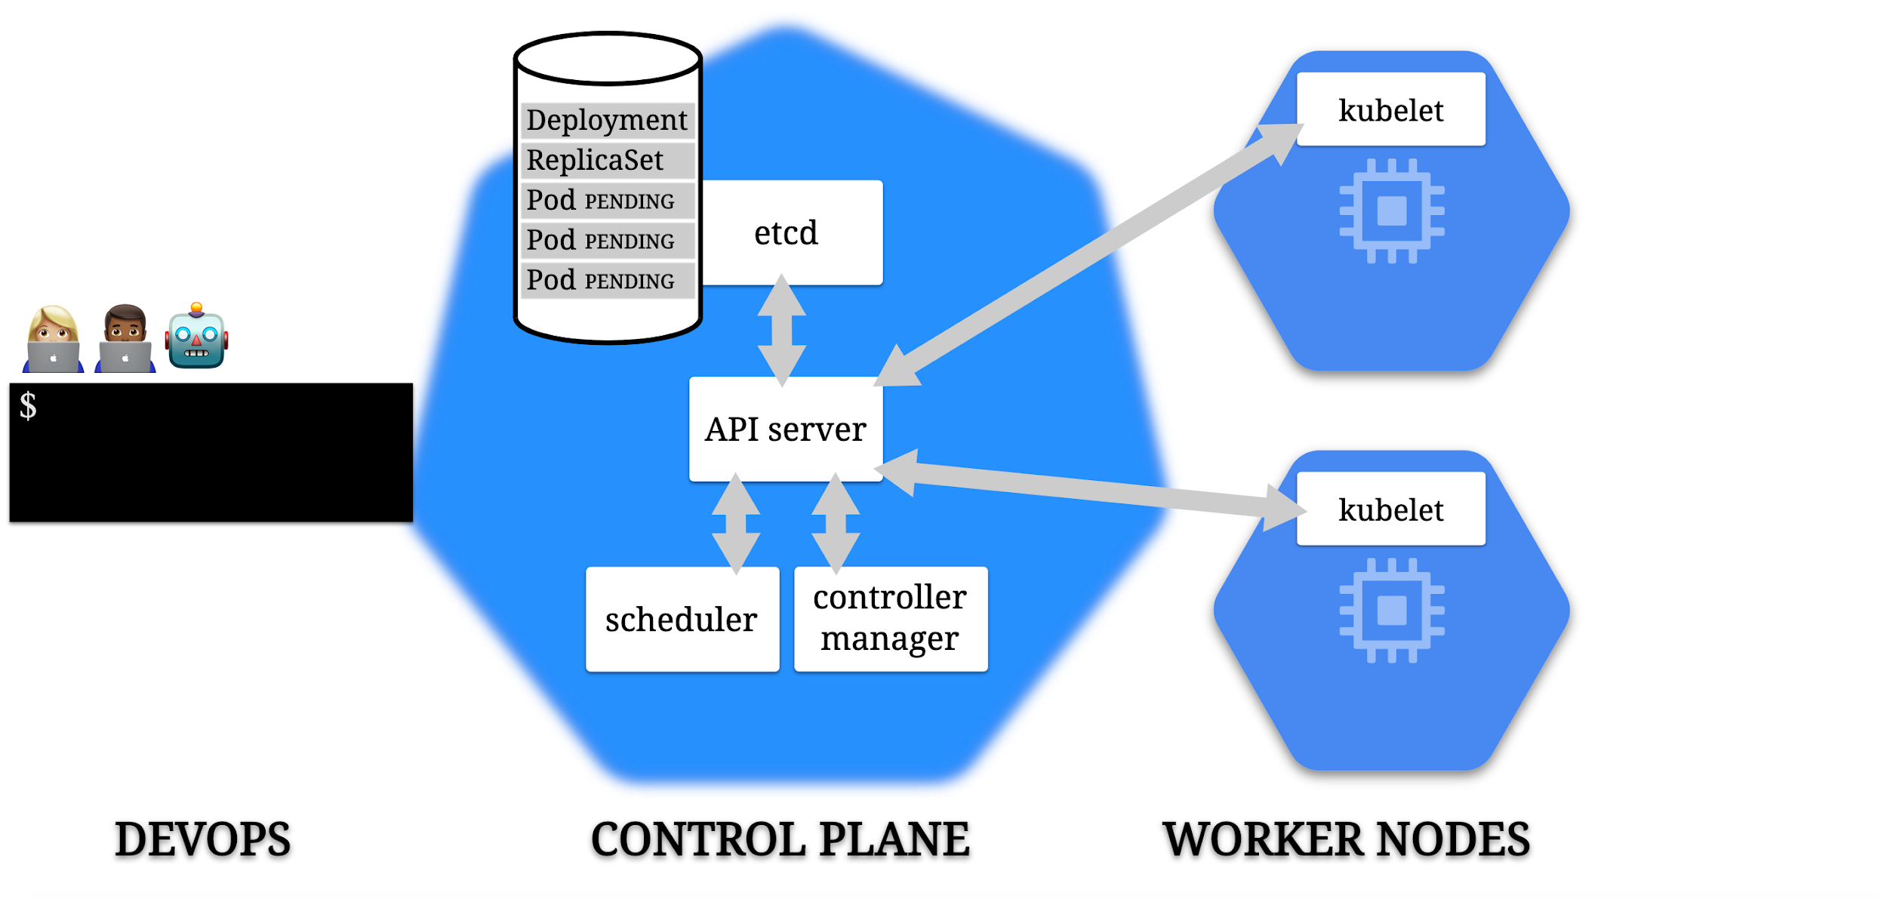

Slide 86
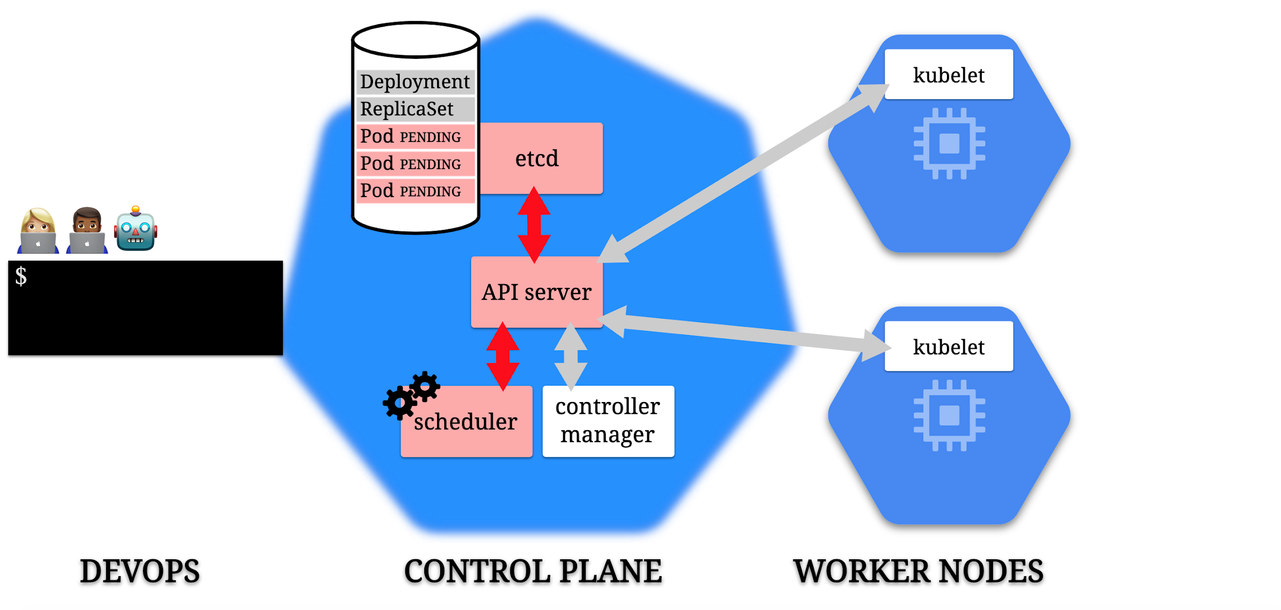

Slide 87
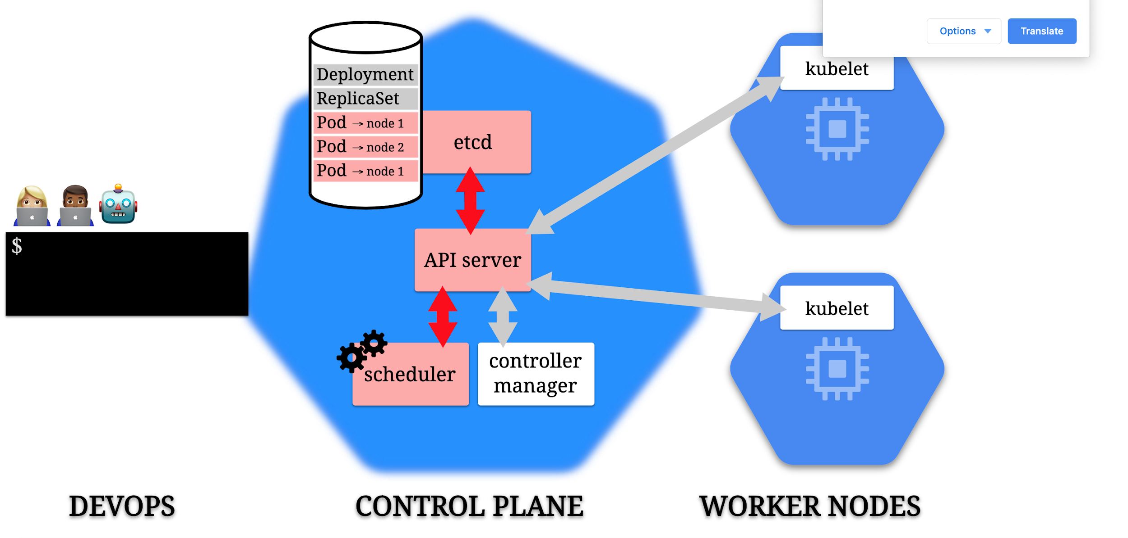

Slide 88
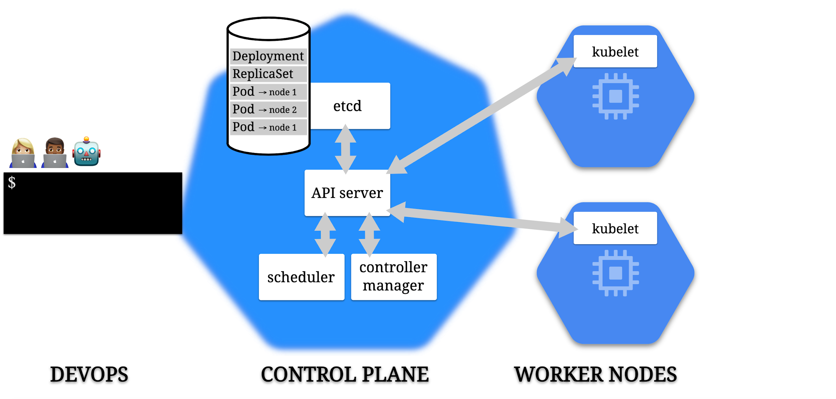

Slide 89
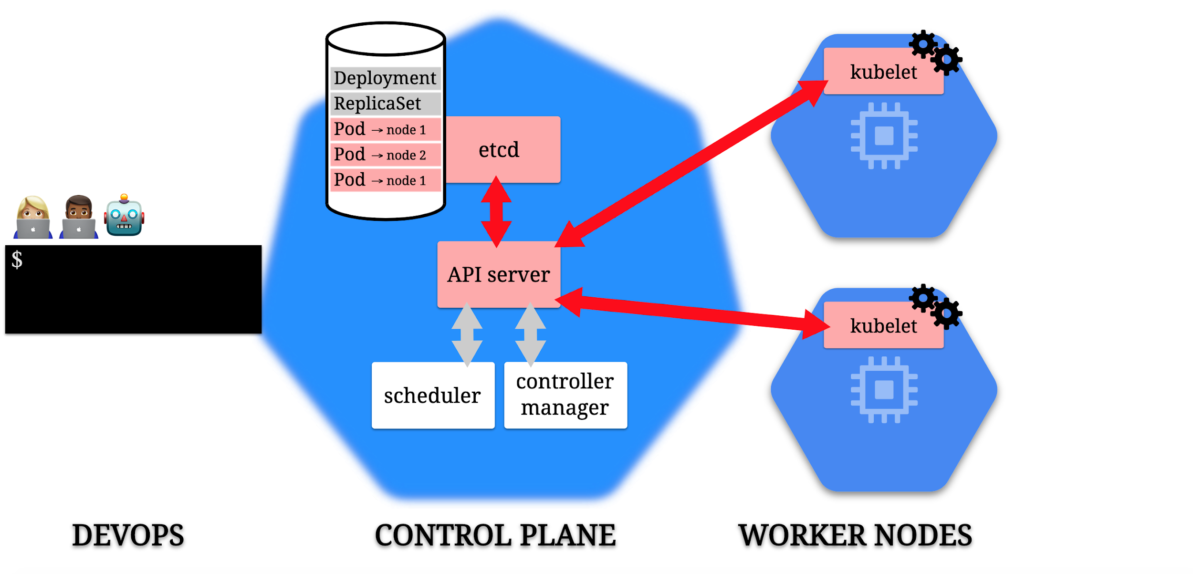

Slide 90
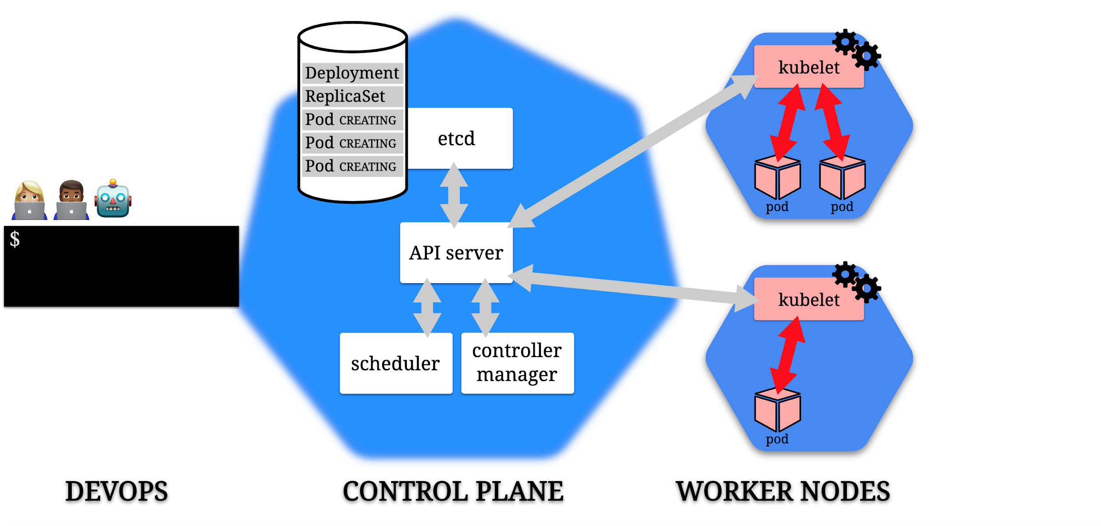

Slide 91
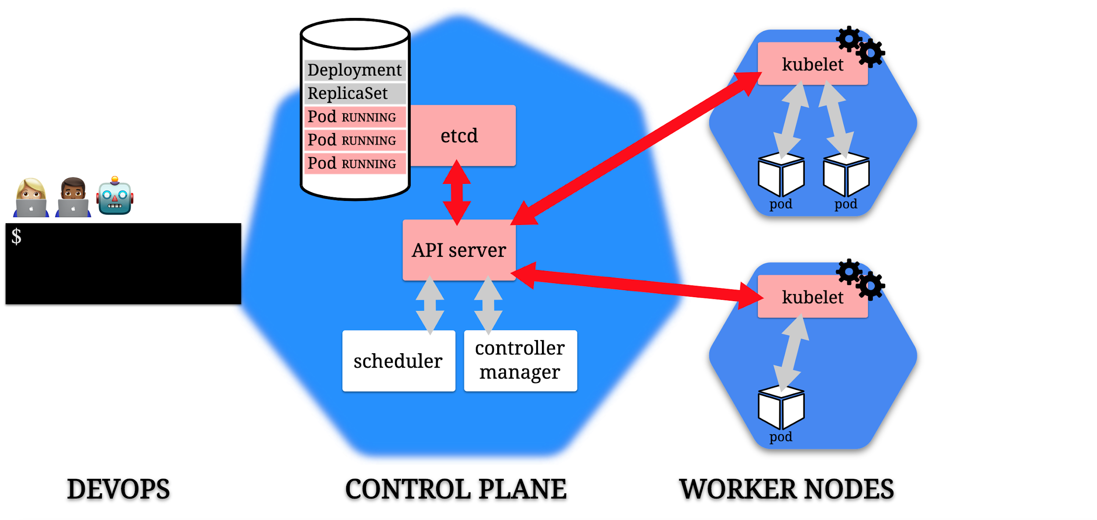

Slide 92
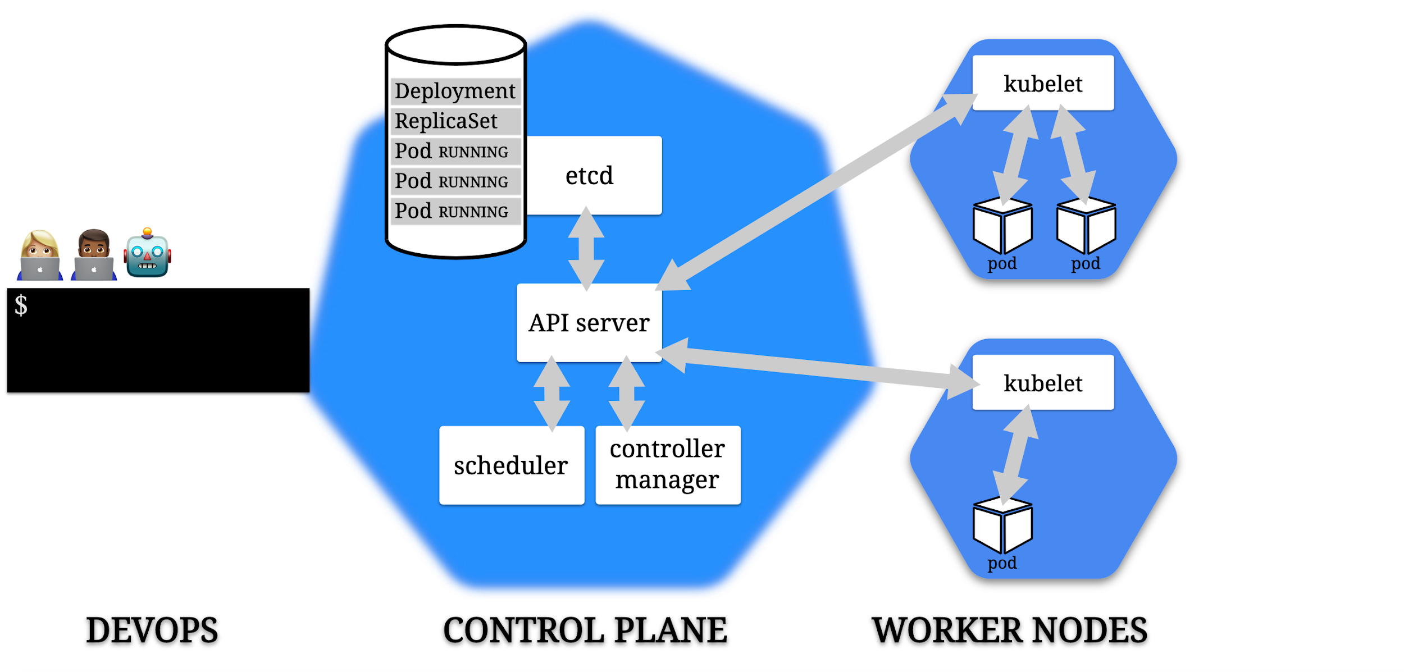

Slide 93
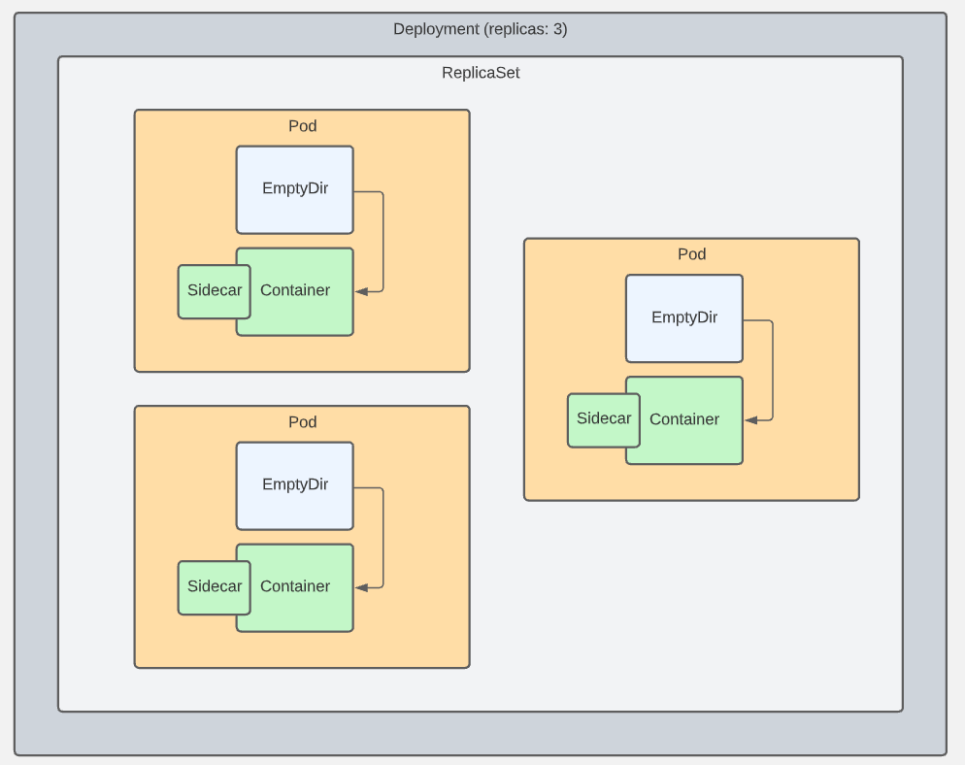
Pods, Deployments, & ReplicaSets

Slide 94
Question for the Group
This component is used in a Kubernetes cluster to store state about the cluster and the resources it is responsible for:
API server
Scheduler
etcd
Controllers
Type your choice in the chat…

Slide 95
Question for the Group
This component is used in a Kubernetes cluster to monitor current state against desired state, and notify the cluster when an update is required to resolve any gaps:
API server
Scheduler
etcd
Controllers
Type your choice in the chat…

Slide 96
Question for the Group
This component provides the programmatic interface to the Kubernetes cluster and is used by other components and users for retrieving data about the cluster and applying changes to the cluster:
API server
Scheduler
etcd
Controllers
Type your choice in the chat…

Slide 97
Control Plane: The API
The fundamental fabric of Kubernetes
RESTful API
Enables all communication between k8s components, and all operations they can do
Enables external user commands into the cluster

Slide 98
Master in more detail
The Master is composed of multiple components
kube-apiserver which is the front facing interface into the master exposes its interface via REST api and consumes json or yaml
Etcd is the cluster store – an open source distributed key value database used to keep the state and config for the cluster
We send a manifest file that defines our intents to the api server, the api server validates it, and saves it to the cluster store

Slide 99
Master in more detail
kube-scheduler
Component on the master that watches newly created pods that have no node assigned, and selects a node for them to run on
Factors taken into account for scheduling decisions include individual and collective resource requirements, hardware/software/policy constraints, affinity and anti-affinity specifications, data locality, inter-workload interference and deadlines
kube-controller-manager - Component on the master that runs controllers
Node Controller: Responsible for noticing and responding when nodes go down
Replication Controller: Responsible for maintaining the correct number of pods for every replication controller object in the system
Endpoints Controller: Populates the Endpoints object (that is, joins Services & Pods)
Service Account & Token Controllers: Create default accounts and API access tokens for new namespaces

Slide 100
Control Plane Components: kube-apiserver
Exposes the API for the control plane
It can scale as traffic increases

Slide 101
Control Plane Components: kube-controller-manager
Controllers are what keep the desired state maintained
The kube-controller-manager runs all controllers in the cluster

Slide 102
Control Plane Components: cloud-controller-manager
Acts as liaison between the cluster and your cloud provider

Slide 103
Node Components: kubelet
Makes sure the pods in the node stay running and healthy
They operate off the “spec” in a pod’s manifest YAML file

Slide 104
Node Components: kube-proxy
Manages network communication to pods
Every pod has one as a network proxy

Slide 105
Node Components: Container Runtime
The software that runs the containers in the pod
Docker is most common
Others are containerd and CRI-O
They need to comply with a standard called Kubernetes CRI

Slide 106
Addons: Cluster DNS
A DNS system that runs in a pod in your cluster
It also spins up a k8s Service
Allows the use of consistent DNS names instead of IP addresses

Slide 107
k8s Probes
The pods in a node are not always up and running, ready for incoming traffic
We need a way to check
The kubelet does this through periodic “liveness” checks into the pods in its node

Slide 108
kubectl
kubectl (“kube-cuttle”) is command-line tool used to interact with API
May require installation (automatic if using k8s via Docker Desktop)
Config file defines details of connection to cluster (e.g., ~/.kube/config)
Run `kubectl cluster-info` to confirm connectivity
Run `kubectl` from command-line (with arguments) to see options
NOTE: k8s in Docker Desktop should handle most of this for you

Slide 109
Lab 03

Slide 110
Pod Configuration
Two types of pod: single container and multiple container
Making a single container pod is simple – use kubectl run
$ kubectl run <name of pod> --image=<name of the image from registry>

Slide 111
Pod Design Patterns
Usually, you will have one container per pod
There are cases when multi-container pods make sense: When both pods have the same lifecycle, or they MUST run on the same node.
An example: The primary container needs a helper process – it needs to be in the same node to be utilized.
There are three main patterns for multi-container pods:
Sidecar pattern
Adapter pattern
Ambassador pattern

Slide 112
Multi-container Pod: Sidecar Pattern
Main App plus a “helper” app that isn’t part of the main app
Example: Main app is a web app; helper is a logging utility

Slide 113
Multi-container Pod: Adapter Pattern
Used when you need to standardize output form various apps in the cluster
Each app type may format output in a unique way, but the cluster’s monitoring needs to work with standardized formats
Adding an adapter container to the pod for each app lets you still use the normal app output format in other areas, but have the cluster-level data work use a standardized format

Slide 114
Multi-container Pod: Ambassador Pattern
One more way to allow the pod’s containers to communicate with the outside world
Add an “ambassador” container to the pod that acts as a proxy for network traffic to and from the primary container
This lets you control traffic patterns based on the specific use case of the pod in question.
Example: database connection in dev/qa/prod environments

Slide 115
Lab 04

Slide 116
Diving Deeper into Kubernetes

Slide 117
Namespaces in k8s
Provide a grouping mechanism in Kubernetes
Every k8s object belongs to a namespace
Every Cluster automatically includes a default namespace

Slide 118
Namespaces in k8s
Allow you create logical separation within a physical Cluster
Provide a boundary for security and resource control
Can explicitly create a namespace and deploy resources to it using namespace field in manifest or --namespace arg on kubectl
Notes:
Could be used to separate by environment, by dev, by test area, or whatever

Slide 119
Namespaces in k8s
Objects within a namespace are isolated from others
Enables creation of multiple instances of same apps with same names
Resources from one namespace can communicate with another namespace using Services
Controller only looks for matching resources in its namespace

Slide 120
Contexts
Can be used to define connection details for a k8s Cluster
Sets the default namespace to be used
Prevents need to specify namespace – will use context to automatically set if excluded (like with default in standard install)
Able to switch between contexts using use-context command

Slide 121
Contexts
Can also be used to manage switching between different Clusters (local or remote)
For remote, API server will be secured with TLS and kubectl uses a client cert for AuthN
Notes:
Execute demo at https://kubernetes.io/docs/concepts/overview/working-with-objects/namespaces/

Slide 122
ConfigMaps vs. Environment Variables
A ConfigMap is an API object that lets you store configuration for other objects to use
These are key/value pairs
This lets you decouple environment-specific config data from your container images, making your apps more portable
CAUTION: ConfigMaps do not provide encryption or secrecy. Use a Kubernetes Secret for that.

Slide 123
ConfigMaps
Can be:
Set of key-value pairs
Blurb of text
Binary files
One pod can use many ConfigMaps and one ConfigMap can be used by many pods
Data is read-only – pod can’t alter

Slide 124
ConfigMaps as Env Vars
Can be created from a literal:
`kubectl create configmap <name> --from-literal=<key>=<value>`
Can be created from a file (to group together multiple settings):
`kubectl create configmap <name> --from-env-file=<file-path>`
Where <file-path> contains .env file like:
key1=value1
key2=value2
Can be created from a .yml definition file (like all things k8s)

Slide 125
ConfigMaps
Can be presented as files inside directories in the container
Uses volumes – making contents of ConfigMap available to pod
Uses volume mounts – loads contents of ConfigMap volume into specific container path in pod
Can contain settings to override defaults

Slide 126
ConfigMaps - Precedence
If env vars defined in multiple places, definitions in `env` section in pod spec will trump others (localized)
Typical approach:
Default app settings “baked in” to container image (e.g., to support dev mode)
Specific settings for an environment stored in ConfigMap and surfaced to container filesystem
Merges with default settings (overwriting where applicable)
Final tweaks can be accomplished with env variables in pod spec

Slide 127
Secrets in Pods
Secrets let you store and manage sensitive information, such as passwords, OAuth tokens, and ssh keys.
A pod needs to reference a secret. There are three ways get to the secret:
As a file in a Volume that is mounted to a container;
As an environment variable for a container;
By the kubelet, when it pulls images for the pod
NOTE: The default config for a Secret does NOT have encryption – data is plain text. You need to configure “Encryption at Rest” for the Secret”, and Role Based Access Control in your cluster

Slide 128
Lab 05

Slide 129
k8s Services
Services are an abstraction
They define a set of pods, and an access policy for them
A pod has an IP address
Pods are ephemeral – what happens to IP traffic if they die?
Pods in a service can have fixed IP addresses that stay the same even if the actual pod dies and is spun up again
Services are k8s objects; they are created like any other

Slide 130
k8s Service Types
ClusterIP (default): IP is internal to the cluster
NodePort: IP for the port is exposed with a static IP address
LoadBalancer: IP traffic to nodes is managed by external load balancer
ExternalName: IP traffic is routed by DNS Name (foo.example.com)

Slide 131
Cluster Access – Internal vs. External
You can access the cluster API using kubectl (“proxy”)
You can get libraries for popular languages that can access the cluster
k8s objects (pods) can also access the API internally
This uses an internal DNS
“kubernetes.default.svc” maps to the API server
The pod usually uses a “sidecar” container to do this

Slide 132
Lab 06

Slide 133
Container File System
Each container in a pod has its own filesystem built by k8s
Can be built from multiple sources, including:
Layers from the container image
Writable layer for the container
Can be expanded with other sources like ConfigMaps and Secrets – mounted to a specific path in a container
Volumes can provide another source of storage – volumes are defined and mounted to containers

Slide 134
EmptyDir
Empty directory stored at pod level vs. container level
Mounted as a volume into the container so visible there
Any data stored there from the container remains in pod between restarts
Replacement containers can access data from predecessors

Slide 135
HostPath
Data physically stored on node in cluster
Extends beyond lifecycle of pod
Available to replacement pods (but only if run on same node)
Mounted as a volume into the container like others
However, can have issues:
In cluster with multiple nodes, limits usefulness
If not careful, can expose large blocks of host data

Slide 136
PersistentVolume
Like pods (abstraction over computer) and services (abstraction over network), persistent volumes provide abstraction over storage
k8s object that defines available section of storage
Can be “mapped” to shared storage (like NFS) or locally (for dev/test purposes)

Slide 137
PersistentVolumeClaim
Pods are not allowed to use persistent volumes directly
Instead, pods claim using PersistentVolumeClaim object type in k8s
Requests storage for a pod
k8s handles matching up a claim to a persistent volume
Provides virtual storage abstracted from actual storage

Slide 138
Dynamic Provisioning
Static provisioning accomplished by explicitly creating persistent volume and then claim (k8s binds claim to volume)
Dynamic provisioning supported as well
You create the persistent volume claim and let persistent volume be created on demand by cluster
Can leverage storage classes for defining and matching types of storage

Slide 139
Storage Classes
Defined by three properties:
provisioner – component that creates persistent volumes on demand
reclaimPolicy – what to do with dynamically created volumes when claim is deleted
volumeBindingMode – eager vs. lazy binding/creation (at same time as claim creation or only when pod using the claim get created)
Also, able to create custom storage classes defined by same properties

Slide 140
Lab 07

Slide 141
Scaling k8s
Manage
Manage
Deployments
ReplicaSets
Pods
Containers
Manage

Slide 142
ReplicaSets
Can be created directly as an object in k8s
However, better practice would be to create/manage through deployments
`replicas` property in pod spec in deployment can be used to build out multiple replicas for a pod config
If not included, defaults to 1

Slide 143
Setting Limits in Deployments
When defining pod spec in deployment, can use limits to manage
`resources` attribute defines compute resource requirements for pod
`limits` can be used to apply limits (e.g., in amount of memory and cpu)
Usually better to optimize once running vs. prematurely optimizing
Target environment when running will help determine correct settings

Slide 144
DaemonSets
daemon is usually a system process that runs constantly as single instance
In k8s, DaemonSet runs single replica of a specific pod on every node in cluster
Usually used for infrastructure-level concerns:
Logging/central data collection
High availability for a reverse proxy running in cluster
Looks similar to other controllers (e.g., Deployment) but no replica count

Slide 145
Using DaemonSets in Deployments
Control loop watches for nodes joining cluster
New pod instance for the daemon will be started on new node
Works to stop/remove daemon pod(s) if node(s) taken out of cluster

Slide 146
Using DaemonSets in Deployments
Can also target just a subset of nodes for daemon pod
As with most other things in k8s, use label matching
Watches for nodes join cluster and for metadata matching label
DaemonSet control loop is different from ReplicaSets because has to monitor combo of node activity and pod count

Slide 147
Lab 08

Slide 148
StatefulSets
Represents a Pod controller that enables running apps at scale in a predictable manner
Deployments/ReplicaSets create Pods with random names
Also, starts Pods in parallel
Some use cases (e.g., clustering) require a more deterministic approach

Slide 149
StatefulSets
For example, creating a cluster of PostgreSQL instances
With StatefulSets, can create Pods with predictable names
Can access the Pods individually over DNS
k8s will start the Pods in sequence

Slide 150
StatefulSets
With a PostgreSQL cluster, able to earmark a Pod as primary
Other Pods will wait for the primary and can use primary for replication
Allows clustering of multiple database instances with read-replicas
Pod name will be StatefulSet name followed by an index (starts at 0)

Slide 151
StatefulSets
Provides stability for the deployment
Replacement of missing Pods will respect this ordering
If Pod 0 goes down, a replacement Pod 0 will be created (with same config)
Other Pod indexes will stay in place

Slide 152
StatefulSets
To get access to DNS names for individual Pods, create a “headless” service
Create the service with a clusterIP of None
Does not use fixed IP for the Service
DNS entry for the service returns an IP address for each Pod in the StatefulSet
Each Pod gets its own DNS entry as well

Slide 153
StatefulSets
Can require adjustment to data storage approach
With something like PostgreSQL, each database instance will write data in its own writable layer instead of a shared location
Cannot simply mount a standard PVC for data storage as every Pod would try to write to that volume shared across all Pods

Slide 154
StatefulSets
StatefulSet specification provides a volumeClaimTemplates field
Can include storage class, capacity, and access mode definitions
Each Pod in the spec gets its own dynamically-created PVC
As previously discussed, creates PersistentVolumes for each using defined storage class (or default in not specified)
This link between Pod and PVC remains in place even across Pod replacement

Slide 155
StatefulSets
Keep in mind – StatefulSets are intended to provide a stable and predictable deployment environment
Less flexible than other controller types
Can make changes more impactful
Be sure app requirements fit model

Slide 156
Jobs
Provide options for running maintenance tasks in your k8s Cluster
For example, with PostgreSQL cluster from previous, can schedule tasks against the DB “out-of-band”
Tasks like backing up databases, data migration, data loads, etc.
Defined with a Pod spec and run to completion as a batch process

Slide 157
Jobs
Can run Pods for any container image but should represent a process with a discrete end (intended to run to completion)
Jobs add labels to the underlying Pods created
Includes a completions property for specifying how many times the Job should run

Slide 158
Jobs
And a parallelism property for specifying how many Pods to run in parallel
Enables distribution of Job processing for multiple types/instances across the Cluster
Also, can assist with managing the speed of Job execution

Slide 159

CronJobs
Specific type of Job for executing regularly and on a schedule
Allows definition of a Job spec for use by CronJob for Job creation on the defined schedule
Use the Linux Cron format

Slide 160
CronJobs
Can move CronJobs to suspended state
Logic needs to account for standard Pod lifecycle management
Could include restarts or parallel runs – logic needs to support
Notes:
Leaves in place but won’t run again until reactivated

Slide 161
Lab 09

Slide 162
Startup Probes
First probe executed on startup and determines if app is initialized and ready for traffic
Only runs on initialization – once complete, will not run again in the Pod
Can specify number of probe attempts (failureThreshold)
And number of seconds to wait between retries (periodSeconds)
If all defined attempts fail, k8s will kill the Pod and startup a replacement

Slide 163
Readiness Probes
k8s knows if Pod container is running but not if application inside is healthy (specific to the app)
Defined in the Pod spec
Execute health checks on a fixed schedule

Slide 164
Readiness Probes
Act at the network level and manage routing for listening components
If deemed unhealthy, Pod will be taken out of ready state and removed from list of active Pods
k8s keeps running probe looking for Pods that have recovered for reassociation to the Service
Different types of probes are supported – e.g., HTTP GET for web apps

Slide 165
Liveness Probes
Use same health checks as readiness probes
Action on failure is different
Act at compute level and restart unhealthy Pods
Different types of probes are supported – e.g., HTTP GET for web apps

Slide 166
Managing Logs
k8s collects logs from container runtime and stores as files on node
Goal is to get logs out of the container and potentially centralize for aggregated processing
Often uses a sidecar container for the aggregation

Slide 167
Managing Logs
Logs can benefit from normalization
Parsing can be applied as the information passes through the pipeline
Several 3rd party tools (e.g., Fluentd for log collection, Elasticsearch for log storage, and Kibana for view)

Slide 168
Deploying and Scaling Clusters
Clusters can scale as needed
Increased load
Rolling cluster updates
This is often managed by the cloud provider with cloud native

Slide 169
Managing Cluster Resources
Container limits provide options for specifying limits at the container level
Allow specification of memory and cpu limits to prevent a container from exhausting cluster resources
Can be defined using “requests” and “limits” in container spec
“requests” define what is requested (like a minimum) – container can use more than what’s defined if node provides
“limits” are hard stops – if exceeded container will be replaced

Slide 170
ResourceQuota
Also, able to apply resource limits at the namespace level
Pod specs need to include a resource section
Container limits are reactive; ResourceQuotas are proactive
Pods won’t be created if they would exceed limit

Slide 171
Lab 10

Slide 172
Rolling Deployments
Code changes, so your pod (containers) change
We want a stable experience for users
k8s does this via rolling deployments
As updates nodes become available, traffic is load balanced to ensure uptime

Slide 173
Rollouts
When applying a change to an existing deployment, k8s manages transition (from previous to new) gracefully
Spins up new ReplicaSet and scales to the configured number of replicas
At the same time, scales down the previous to 0
Process helps minimize downtime for your running app

Slide 174
Rolling Back
If newly deployed version of app gets pushed and issues are found, can rollback to a previous, working version
Can use kubectl rollout undo deploy/<deployment name> --to-revision=#
The --dry-run argument can show you what kubectl would do if the given command were executed (before execution)

Slide 175
Demo – Rollout with RollingUpdate Strategy
Notes:
Rollout with RollingUpdate strategy

Slide 176
Deployment Update Strategies
Deployments support two update strategies
RollingUpdate (the default)
Recreate
Recreate still uses ReplicaSets to implement the update but scales down previous to 0 before scaling up a replacement
Should only use where multiple versions of your app should not coexist – consistency more important than minimized downtime

Slide 177
Demo – Rollout with Recreate Strategy
Notes:
Rollout with Recreate strategy

Slide 178
Configuring RollingUpdate
There are settings that can be used to “tweak” the RollingUpdate strategy:
maxUnavailable – controls how quickly the old gets scaled down by defining the number of pods that can be unavailable
maxSurge – controls how quickly the new gets scaled up by defining the number of extra pods that can exist above the defined replicas setting

Slide 179
Configuring RollingUpdate
Deployment
replicas: 3
maxSurge: 1
maxUnavailable: 0
New pod gets created before an old one is taken offline (create-then-remove)

Slide 180
Configuring RollingUpdate
Deployment
replicas: 3
maxSurge: 0
maxUnavailable: 1
Old pod is taken offline before new pod gets created (remove-then-create)

Slide 181
Configuring RollingUpdate
Deployment
replicas: 3
maxSurge: 1
maxUnavailable: 1
Old pod is taken offline, and two new pods can be created (remove-and-create)

Slide 182
Additional Configuration
There are settings that can be used to “tweak” how quickly deployments are executed (defined in the Deployment spec):
minReadySeconds – inserts a delay which causes the Deployment to wait a specified number of seconds a pod should be up with no crashed containers before it’s considered successful; default is 0 (creates pods quickly)
progressDeadlineSeconds – specifies amount of time a Deployment update can run before being considered failing to progress; default is 600 seconds or 10 minutes
Notes:
Rolling updates are also available with DaemonSets and StatefulSets – though they operate a little differently (DaemonSets only have one instance running on each node so only maxUnavailable / StatefulSets control order but partition can be used to divide updates across a deployment)

Slide 183
Demo – Rollout with RollingUpdate Configuration

Slide 184
Blue/Green Deployments
How they work: keep two identical environments, conventionally called blue and green, to do continuous, risk-free updates. This way, users access one while the other receives updates.
With bare metal servers, this is expensive – one of the environments isn’t used much when the other is
k8s makes this easy – we can make a second environment, switch traffic over, then kill the first with little impact
Will need capacity in cluster to run two complete copies of app

Slide 185
Canary Pods for Testing and Production
A strategy to try out a new feature only for a small segment of users or traffic (A/B testing or cautions deploy)
k8s makes this easy
Use a tag to designate what pods will receive a small percentage of traffic
Also, allows smoke testing on small scale before “opening floodgates”

Slide 186
Lab 11

Slide 187
Demo – Log Aggregation Using EFK (Elasticsearch, Fluentd, Kibana)
Notes:
Chapter 13

Slide 188
The Ingress Controller
Specialized load balancer for k8s environments
Manages traffic to pods in your cluster
Like Nodes, Services etc., they are deployed using the cluster API
There are several available besides the k8s offering

Slide 189

The Ingress Controller
Notes:
https://stackoverflow.com/questions/49514702/kubernetes-ingress-with-multiple-target-rewrite#:~:text=nginx.ingress.kubernetes.io%2Frewrite-target%3A%20%2F%20This%20will%20rewrite%20the%20target%20of,names%20as%20they%20are%20in%20the%20root%20directory.

Slide 190
Demo – Ingress Controller
Notes:
https://kubernetes.io/docs/concepts/services-networking/ingress/
https://redhat-scholars.github.io/kubernetes-tutorial/kubernetes-tutorial/ingress.html
https://matthewpalmer.net/kubernetes-app-developer/articles/kubernetes-ingress-guide-nginx-example.html
https://kubernetes.github.io/ingress-nginx/deploy/

Slide 191
Demo – Prometheus
Notes:
Chapter 14

Slide 192
Demo – Scheduling & Scaling
Notes:
Chapter 19

Slide 193
Helm

Slide 194
Helm
No real concept of “applications” in k8s
Each “application” is a collection of YAML files that define the required resources
Helm provides the concept of a repository in which the set of YAML files for an “application” can be stored and pulled/executed together
Supports concept of public and private repositories
Separate install → https://helm.sh/docs/intro/install/

Slide 195
Helm
To use a repository, add using helm repo add <local name> <url>
Update local repository cache using helm repo update
Use helm search repo <app name> --versions to search for app in the repository cache

Slide 196
Helm
Client-side tool that uses same connection info as Kubernetes
Extends YAML to provide support for things like parameters
An “application” package is a chart
Charts can be developed/deployed locally or published to a repository
Installing a chart creates a release
Each release has a name – can install multiple instances of same app by using different names

Slide 197
Helm
Manifests in a chart can support parameters
Allows varying specific settings at time of install
Each chart contains a set of default values

Slide 198
Helm
Use helm show values to see defined default values for parameters
Use helm install to install a chart
Use --set flags on install to change parameters from defaults
helm ls will show you installed releases

Slide 199
Helm
Can create your own charts
helm create scaffolds a boilerplate structure
Provides Chart.yaml, values.yaml, templates folder
Use {{ }} to templatize your manifest with a parameter
Can use helm lint to validate contents of chart

Slide 200
Demo - Helm
Notes:
Demo `helm create`
Demo https://bitnami.com/stack/wordpress/helm

Slide 201
Role-Based Access Control (RBAC)

Slide 202
RBAC (Role-Based Access Control)
System of “least privilege”
Allow only, no deny – absence of a permission implies denial
RBAC is used to grant permissions on resources in k8s
All resources can be secured
Permissions get applied to a subject (user, service account, group) but not directly

Slide 203
RBAC (Role-Based Access Control)
Set permissions in a role
Apply a role to one or subjects using a role binding
Role and RoleBinding operate at the level of namespace
ClusterRole and ClusterRoleBinding operate at the cluster level

Slide 204
RBAC (Role-Based Access Control)
Kubernetes does not authenticate end users – delegates to external identity providers
Able to connect to your corporate provider (for example, LDAP or Active Directory)
Cloud k8s offerings integrate with their available provider
Can configure custom OIDC (Open ID connect) provider but not a simple task
If using a managed k8s service, authentication will be built in

Slide 205
RBAC (Role-Based Access Control)
One option to create a “user” within Kubernetes is via certificates
Kubernetes can issue client certificates for end users requested with a username
Certificate supplied on Kubernetes API requests is used to validate permissions to accomplish a task – attached by name
Permissions are all additive – start with none (“least privilege”)
Able to impersonate a user using the --as flag on a kubectl command

Slide 206
RBAC (Role-Based Access Control)
Common approach is to start with predefined cluster roles and bind to one or more subjects for a specific namespace
Role bindings provide a layer of abstraction between users and the roles they have

Slide 207
Demo - RBAC
Notes:
Chapters 16 and 17

Slide 208
Hack-a-thon

Slide 209
Demo – Bringing it All Together (Azure / AKS)
Notes:
Deploying AKS with RBAC → https://docs.microsoft.com/en-us/azure/aks/manage-azure-rbac#:~:text=To%20add%20Azure%20RBAC%20for%20Kubernetes%20Authorization%20into,It%20doesn%27t%20allow%20viewing%20roles%20or%20role%20bindings.

Slide 210




Thank you!
If you have additional questions, please reach out to me at:
(email address)
Notes:
Mandatory -- Need bookend -- first and last thing they should see is DevelopIntelligence
ACTION: Use this for the final slide of your class materials. Include contact information so participants can reach you if they have questions after the course.

